Slide 1
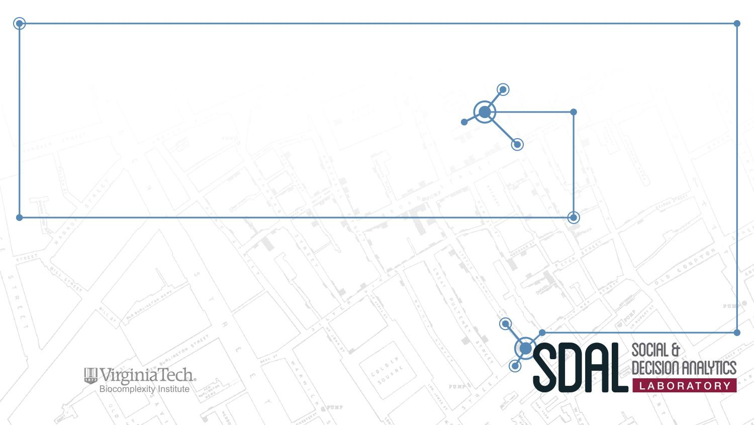
DSPG 2017 Project Reviews
July 12, 2017

Slide 2
Tentative Agenda
8:00 - 8:20 coffee & bagels upstairs
8:30 AM - NSF Projects:
NSF Open Source Software
NSF Business Innovation
NSF STEM Education
10 min Break
9:30 AM - Community Projects:
Alexandria - Equity
Fairfax - Youth Projections
Roanoke - Refugees
10 min Break
New Kent - Teens
Arlington - Needs Assessment
ARI Base Profiling
~12 PM Lunch Break - pizza provided -
12:30 PM Projects:
WMATA
AC 911
DHS
SCHEV

Slide 3

Measuring the Scope and Impact of Open Source Software
PI & Co-PI: Gizem Korkmaz & Stephanie Shipp
Team: Claire Kelling (Penn State), Sayali Phadke (Penn State)
Ben Swartz (VT), Eirik Iversen (VT), Ronnie Fecso (VT)
Sponsor: National Science Foundation (NSF) –
National Center for Science and Engineering Statistics (NCSES)

Slide 4
Introduction
Can we measure the scope & impact of open source software (OSS) using publicly available data?
OSS is currently not measured as a university research output (e.g., publications, patents)
The project aims to test the feasibility and to develop methods to measure the impact (e.g., cost and benefit) of open source software (OSS).
Goals:
Understand the “universe” of open-source software
How much is in use (stock), how much is created each year (flow)?
Created in which sectors? Who are the creators?
OpenHub: Commercial, Non-profit, Education, Government
Created in what categories? Who uses it?
Sourceforge: Science and Engineering, Games, Graphics, etc.
Case study: R packages in Depsy
Model-building to understand impact of individual software packages

Slide 5
Universe - OpenHub
Online community and public directory of free and open source software
Connected to source repositories and regularly updates information
Information organized by:
Projects (n = ~676,523)
Organizations (n = 698)
People / Contributors (n = ~291,782)
Data Collection: Using API -- each key allows for 1000 calls per day (using IDs)
Project ID can retrieve six tables:
Development activity, Contributors to project, Users of project etc.
Organization ID can retrieve five tables:
Contributors, Projects, Organization information
User ID can retrieve five tables:
User’s geographical and professional details, Achievements, Projects used etc.
Notes:
Must collect IDs (project, account, org) before collecting other information

Slide 6
OpenHub: Projects
Selected 33 variables to collect from API (e.g., description, user_count, tags)
Two data collection strategies (for ~676,523 projects):
Random sample
Selected variables queried for random 79,813 projects (12% of all projects)
API returned data on 46,005 projects
This sample is 6.8% of all OpenHub projects
Most relevant projects
Selected variables queried for top 73,000 projects
API returned data on 55,217 projects
This sample is 8.2% of all OpenHub projects
Most relevant project data tables are better populated than average
Notes:
tags are keywords added to a project by a user

Slide 7
Column name | %Missing (Relevant) | %Missing (Random) |  | Column name | %Missing (Relevant) | %Missing (Random)
Overall data | 24.36 | 42.36 |  | 12 month contributor count | 0 | 0
created_at | 0 | 0 |  | total contributor count | 0 | 0
updated_at | 0 | 0 |  | 12 month commit count | 0 | 0
description | 5.69 | 6.41 |  | total commit count | 0 | 0
user count | 0 | 0 |  | total code lines | 0 | 0
average rating | 75.68 | 95.48 |  | main language | 0.87 | 0.43
rating count | 0 | 0 |  | factoids | 0.02 | 0.01
review count | 0 | 0 |  | tags | 51.61 | 70.18
last analysis update | 0 | 0 |  | licenses | 36.29 | 53.06
last source code access | 0.81 | 0.38 |  | languages | 0.04 | 0.04
ohloh 1st month of analysis | 0 | 0 |  | language percentages | 0.04 | 0.04
ohloh latest month of analysis | 0 | 0 |  | activity index | 0 | 0
Notes:
talk about the Tags story
total code lines describes how much effort has been put into a project. This variable can be used to estimate development cost of a project in dollars using the Constructive Cost Model or COCOMO
licenses dictate how projects can be shared and modified

Slide 8
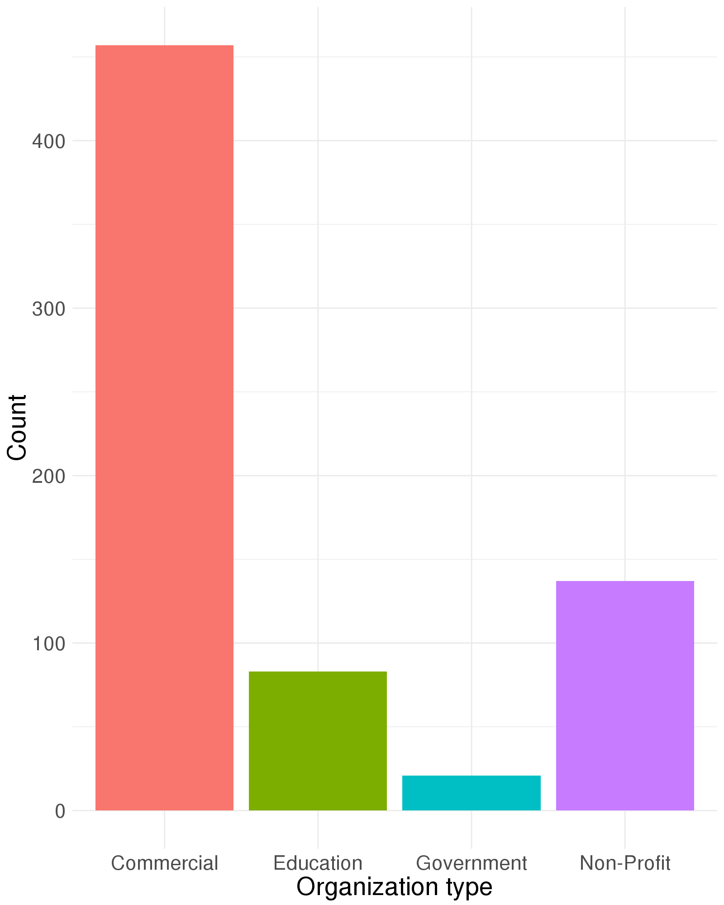
OpenHub: Organizations (n=698)
Commercial
Education
Government
Non-Profit
Notes:
We summarized organization data first because it was the smallest group

Slide 9
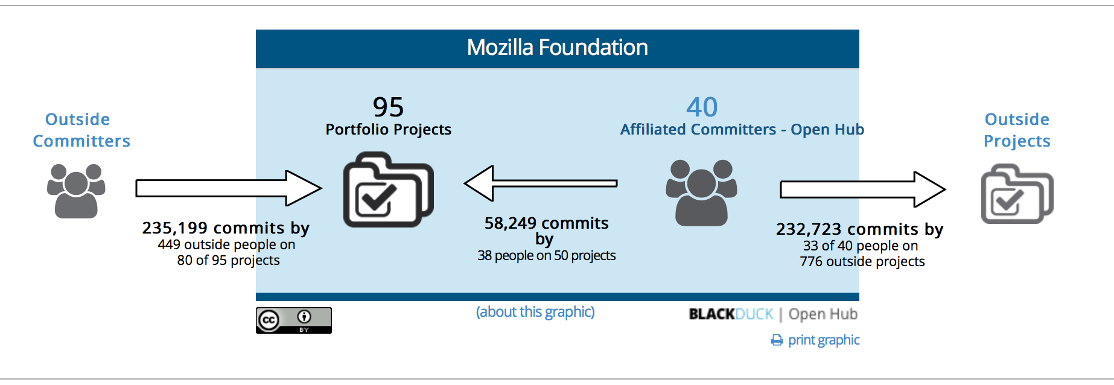
OpenHub: Organizations
Outside committers working on portfolio projects
Outside projects affiliators are committing to
Source: https://www.openhub.net/orgs/mozilla
Notes:
Structure of an organization (OpenHub website)
An organization has a name. Within it are portfolio projects and affiliated committers (contributors)
Inside blue box outside blue box
Count of orgs without projects or committers

Slide 10
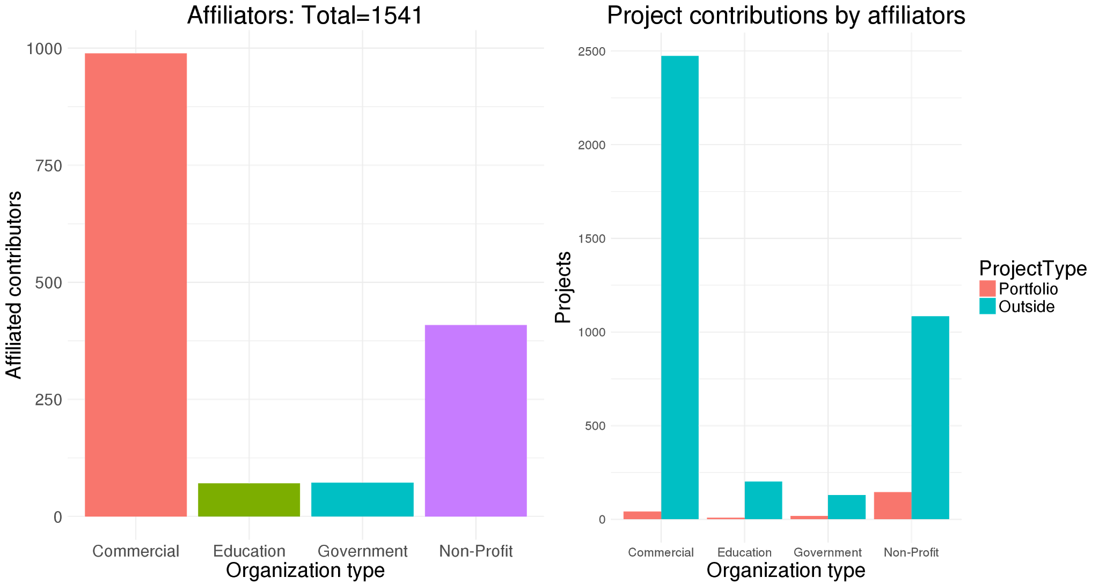
Commercial
Education
Government
Non-Profit
Notes:
affiliated contributors develop projects within their organization and outside

Slide 11
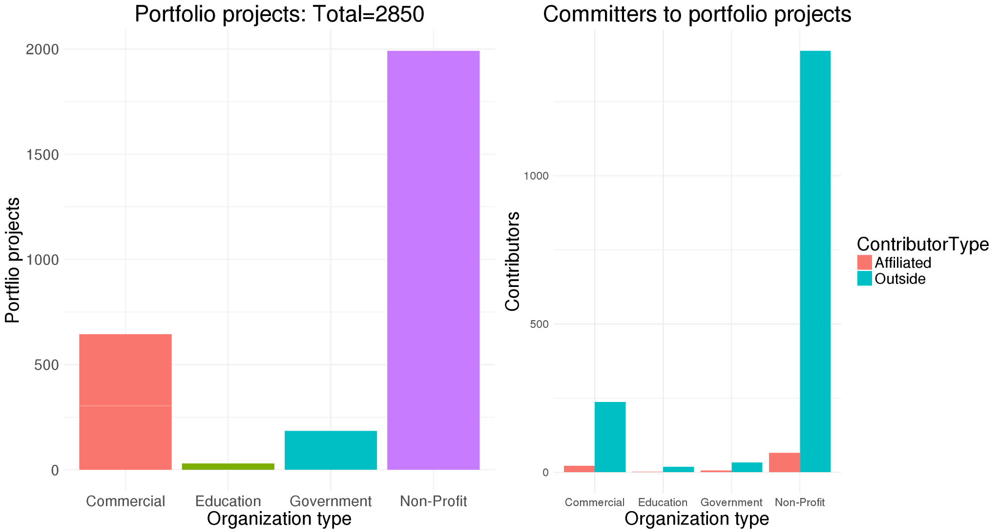
Commercial
Education
Government
Non-Profit
Notes:
portfolio projects are developed by contributors within and outside the organization

Slide 12
OpenHub
Challenges
Computational complexity:
Lab generated 22 keys => 22,000 API queries each day
~250 days to collect ALL information from OpenHub
~45 days to collect main tables on all projects, users, and organizations
Data issues:
Website contains sparsely populated data on certain variables
API breaks frequently, leading to completely missing rows
Next steps
Collecting user information from OpenHub
Accessing full OpenHub dataset (through NSF contact?)
Analyzing pertinent information such as timeline of OSS development, contributions, types of projects etc.
Notes:
NOTE: Understanding timeline of development. Should it be Understanding timeline of OSS development.
Yes, thank you :) Change incorporated

Slide 13
Sourceforge
An “Open Source community resource” dedicated to helping open source projects be as successful as possible
provides resources for development and distribution
Projects are organized in a directory
Projects (n = ~488,000)
Scraping steps
Use names provided by Sourceforge through their API
Scrape directly from the directories for each package
Took 15+ days of near continuous scraping

Slide 14
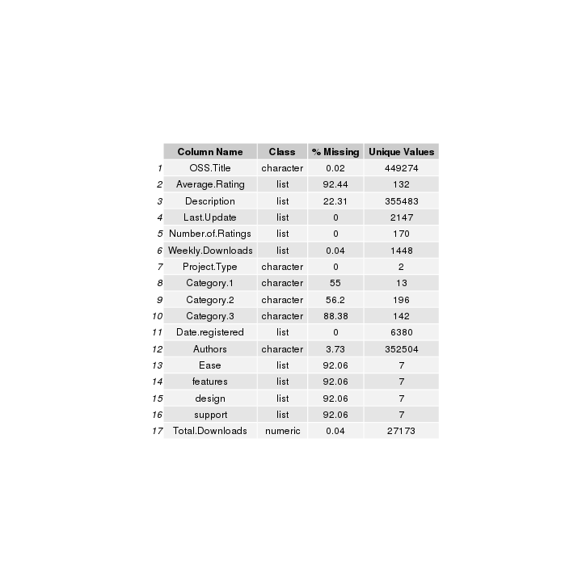
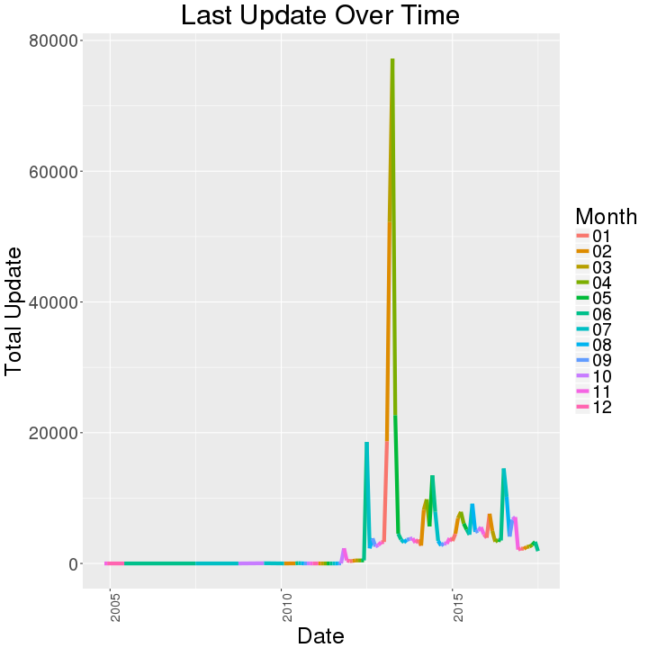
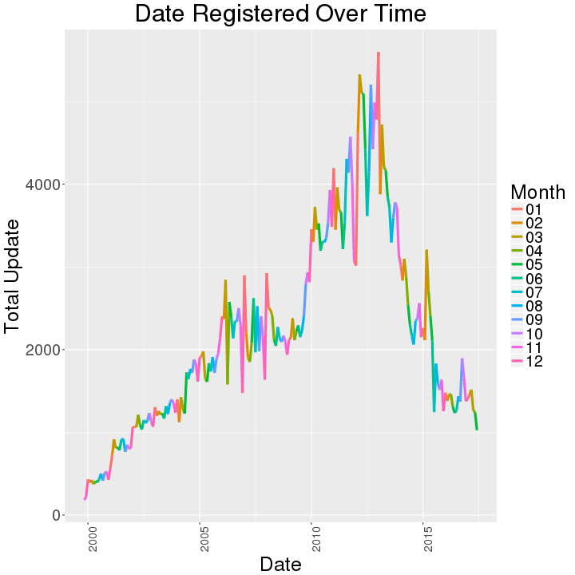
Sourceforge
Data collection
Pulled 488,000+ project names from the Sourceforge API
Number of authors: 352,504
Scraped information from each individual webpage
Notes:
Tables were covering text. Reduced size of tables.

Slide 15
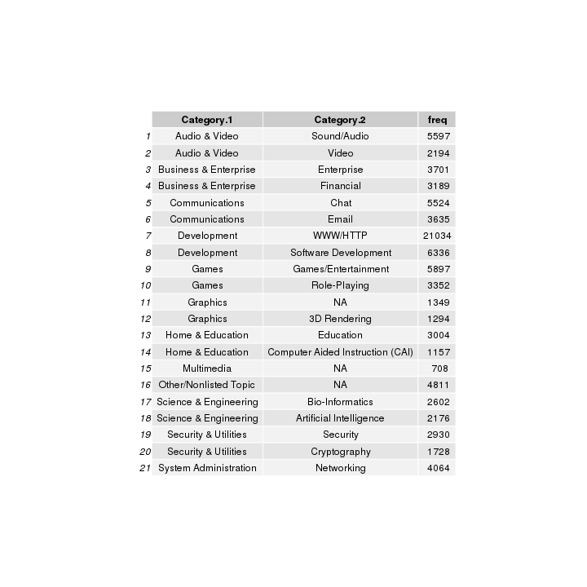
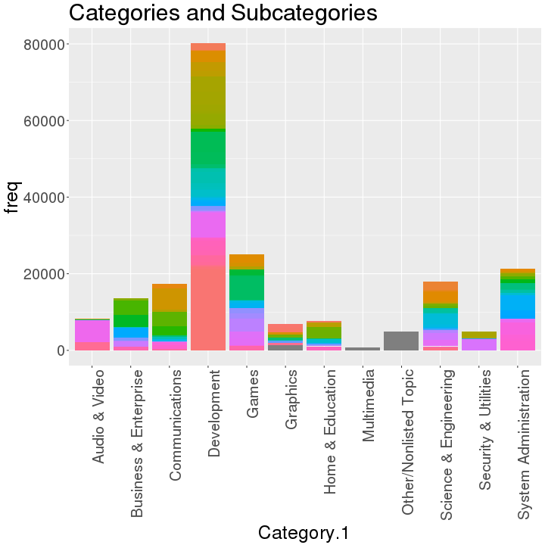
Sourceforge

Slide 16
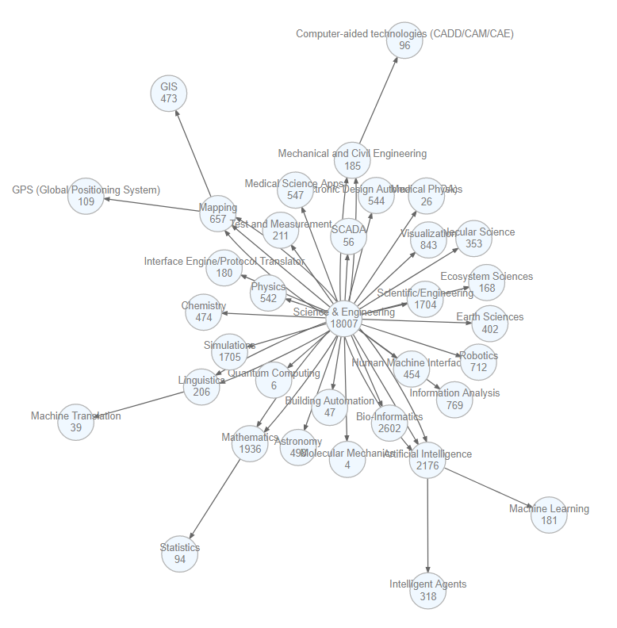
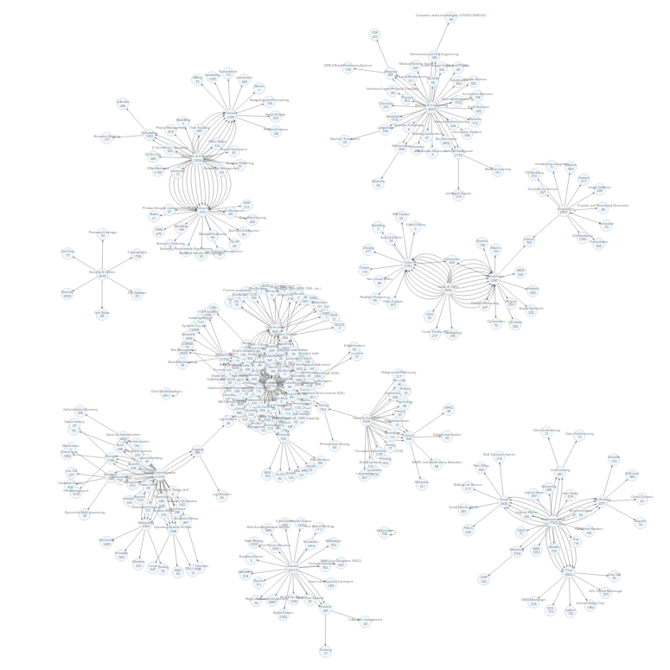
Sourceforge

Slide 17
Sourceforge
Challenges
Computational complexity:
15+ days to scrape
Adding social media information would have drastically increased time
Data Complexity
Some of the names are in foreign languages
Not too many quantitative variables to analyze
Next steps
Analyze impact of various factors on Total Downloads
Learn more about how these softwares are clustered (machine learning)

Slide 18


Sourceforge vs. OpenHub
Terms in common and differences:
Stemmed words created from the Descriptions
11,000+ packages in common

Slide 19
Case Study - R Packages (source: depsy.org)
A project through ImpactStory, started with NSF funding, to give credit to authors of Open Source projects.
Data Collection
Gathered all of the names from CRAN
10,926 packages listed
Scraped the characteristics from the JSON page affiliated with each package
9,810 of these packages were on Depsy
90% of the packages
Potentially uploaded after September, 2015 (Depsy’s last update)
Notes:
Potential future work
Depsy also has information on ~2,000 Python packages

Slide 20
Case Study - R Packages (source: depsy.org)
Six tables through the Depsy API:
Package Matrix:
9,810 entries
24 variables such as git owner, number of committers, number of downloads
Contributor Matrix:
24,000 entries
17 variables such as main language, roles, number of citations
Tag Lists (such as bayesian, finance, experimental design)
Top Neighbors
Top Contributors
Dependency Matrix

Slide 22
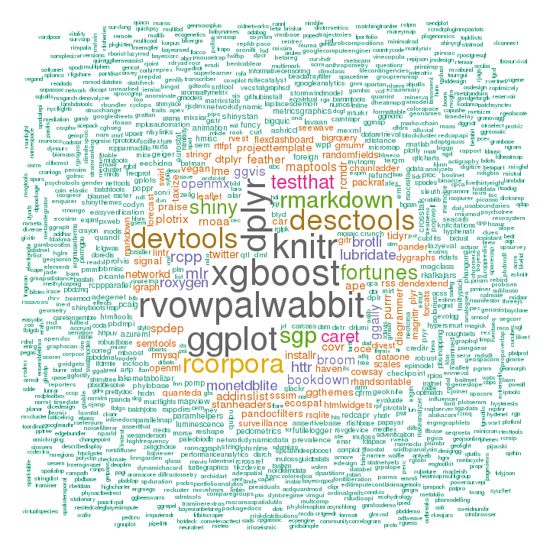
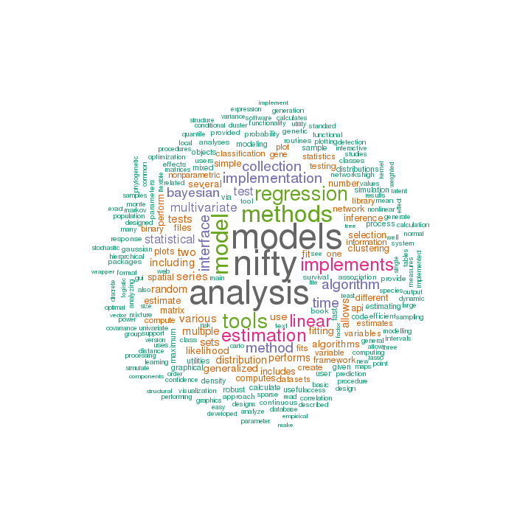
Case Study - R Packages (source: depsy.org)
Packages with the most contributors:
Most used words in the project summary:

Slide 23
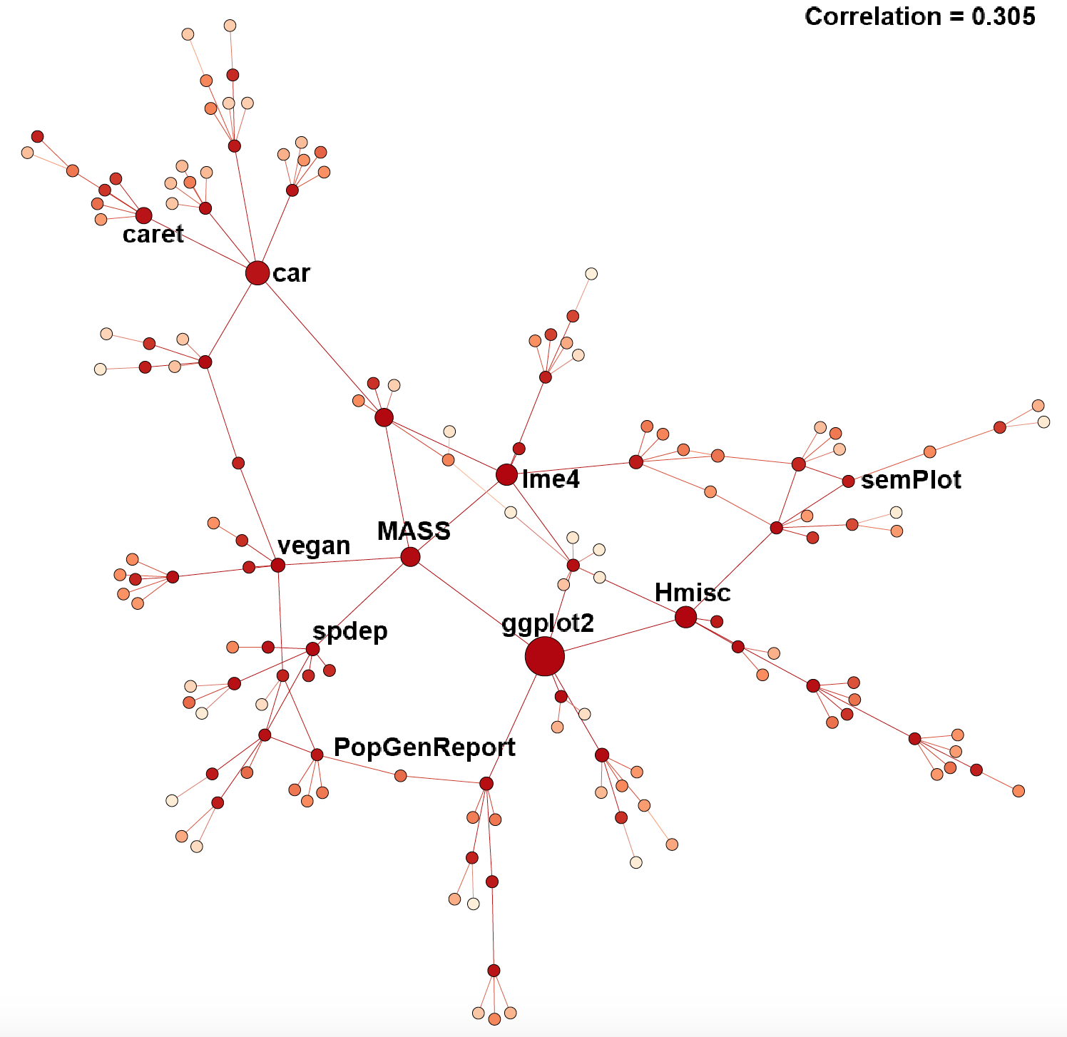
Next Step: Network of R Packages
Conduct exploratory network analysis
Generated dependency network of R Packages
7,547 nodes
20,641 directed edges
Develop statistical models to characterize factors that affect ‘impact’ of an R package
node characteristics
network measures

Slide 24
Conclusion
Next Steps:
Complete data collection, where appropriate
Begin model building
Ongoing questions:
How do we define impact/cost/benefit?
How do we define the universe?
How do we keep up with the speed of OSS innovation?

Slide 25
Questions
Thank you.
Comments?
Suggestions?

Slide 26
Measuring Business Innovation
PI & Co-PI: Gizem Korkmaz & Stephanie Shipp
Team: Claire Kelling(Penn State), Harsimrat Pandher(VT), Daniel Wilkin(VT),
David Park(VT), Joseph Kim(VT)
Sponsor: National Science Foundation (NSF) –
National Center for Science and Engineering Statistics (NCSES)

Slide 27
Introduction
Innovation - “implementation of a new or significantly improved product, process, marketing method, workplace organization, or new organizational method.” (Oslo Manual)
Current NSF Method - Surveys
Business R&D and Innovation (BRDIS) Survey
Shortcomings
Separating R&D from Innovation Survey
Research Question - Can we measure business innovation using non-traditional sources (administrative and opportunity data (e.g., websites, product announcements, social media)?
Goals:
Focus on product innovation
Identify accessible, external data sources for product launches
Company deep dives
Notes:
Shortcommings - not everyone can be given survey, cost, effort
Products innovation - released in market

Slide 28
Data Discovery Process
Procter & Gamble
Company Websites
Company Websites
Company Deep Dives
Capital One
Social Media
Social Media
Luna Innovations
Internal Sources
Deep Learning
Crunchbase Competitors + Similar Databases
External Sources:
Websites
Databases
Crunchbase
Nielsen
Annual Innovation Reports
Notes:
The companies provided information from comanpy websites, social media, and internal sources which led to external sources.
Through deep dive, found CrunchBase -> database -> compnay info, news reports
Nielsen had Annual innovation reports -> Top 10 innovations -> Followed these innovative products to product launches

Slide 29
Data Discovery Process
Identify criteria to classify discovered sites/databases as potentially useful:
Does it mention a launch?
Does it have a specific launch date?
Was the article released at the time of the launch?
Can the previous criteria be applied to other products?
How accessible is it?
Is it scalable?
Notes:
Once we started finding databases and websites, had to come up with rating system

Slide 30
Data Discovery Process
Procter & Gamble
Company Websites
Company Websites
Company Deep Dives
Capital One
Social Media
Social Media
Luna Innovations
Internal Sources
Deep Learning
Crunchbase Competitors + Similar Databases
External Sources:
Websites
Databases
Crunchbase
Nielsen
Annual Innovation Reports

Slide 31
Company Deep Dive
Purpose
Identify potential data sources to measure product innovation
Interview to validate findings (next step)
Initial set of companies:
Procter & Gamble
Capital One
Luna Innovations
Deep Machine Learning
Selection Criteria
Size
Industry
Connections
Notes:
Added ‘next step’ to sub-bullet 3

Slide 32
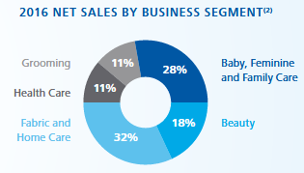

Procter & Gamble
General Info:
Consumer Goods Industry
105,000 employees across 6 continents
Innovation:
“Innovation starts with the customer”
Open Innovation: Connect + Develop
Product & Marketing Innovation
Gillette Flexball, Tide Pods
Data Sources:
P&G Website: “Our Approach to Innovation/ Recent Innovations”
Annual Reports
Social media
https://www.pg.com/it_IT/pdf/Relazione_Annuale_2016.pdf
Notes:
Connect + Develop: internal teams that look for innovations -> help bring innovations to commercial market

Slide 33

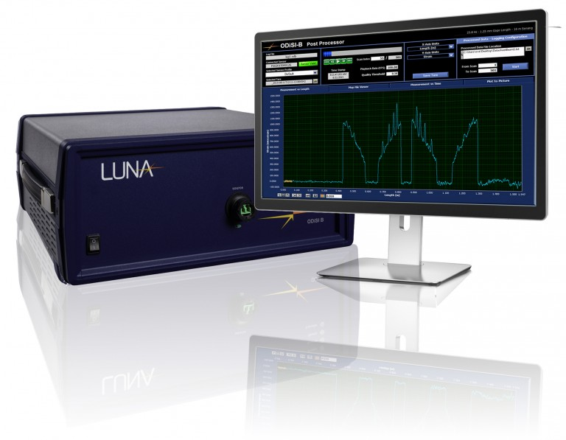
Luna Innovations
General Info:
Founded in Blacksburg, VA
About 185 employees
Aerospace, Telecommunications, Medical, Energy, Defense
Innovation:
Research + Development
Product Development
Fiber Optic Sensor
Successful Products
Data sources:
Local News (Roanoke Times)
Social Media
Notes:
Successful Products: sometimes, if product is successful, they create independent companies that focus around that specific product

Slide 34

Capital One
General Info:
Commercial banking industry
47,300 employees
Headquartered in Mclean VA
Innovation:
“To design new experiences that empower customers to better manage their finances”
ENO - a new text message - based assistant that can help customers with a variety of banking and credit card activities
Capital One Labs and Capital One Digital - Cross functional team that helps Capital One towards the digital banking
Data Sources:
Capital One Website
CrunchBase
Notes:
Capital One Labs: research the next generation to find how they interact with money and banking

Slide 35


Deep Machine Learning
General info
Startup
Founded in Arlington, 2013
Data Analytics Service
Innovation
Focus on government service
Success due to a government contract
There is not sufficient evidence of innovation
Notes:
No Track Record of their service

Slide 36
Data Discovery Process
Procter & Gamble
Company Websites
Company Websites
Company Deep Dives
Capital One
Social Media
Social Media
Luna Innovations
Internal Sources
Deep Learning
Crunchbase Competitors + Similar Databases
External Sources:
Websites
Databases
Crunchbase
Nielsen
Annual Innovation Reports

Slide 37



Nielsen
Report of Top Innovative Products
Contains product spotlights
Gives certain criteria behind determining the winning products

Slide 38
Data Discovery
Documented Information about the company and product
company name, sector/industry, product type, product release date, etc.
Categorized sources based on products in the Nielsen Report
social media, news, blogs, reports, etc.
Evaluated those sources
quality
reasoning

Slide 39
Data Discovery Process
Procter & Gamble
Company Websites
Company Websites
Company Deep Dives
Capital One
Social Media
Social Media
Luna Innovations
Internal Sources
Deep Learning
Crunchbase Competitors + Similar Databases
External Sources:
Websites
Databases
Crunchbase
Nielsen
Annual Innovation Reports

Slide 40
Websites
Company Databases
Websites | Information Provided
Ars Technica | New Technology Launches, News about Gadgets, Gaming, Science, Cars, Business
The Verge | Product Reviews, News about Technology, Science, Culture, Cars
Digital Trends | Best Products Section, Products Reviews, News about all types of technology
Mashable | New Product Releases in Technology, Science, Business
Inc. | Startups, Innovative Ideas, Technology News
Business Wire | Press Releases, News with Multimedia, Company Information
Business Insider | Tech Insider, New Products, News
PR Newswire | New Presses Releases, Product Launches
Food Business News | Food Business News, Consumer Trends, Supplier Innovations, New Food Product Launches
Food Processing | New Food Products, Food News
Mass Device | Medical Product Releases, Medical News
Databases | Information Provided
CrunchBase | Company Information, News Reports, Social Media Links, Product Releases
AngelList | Company Information, News Reports, Social Media Links, Product Releases
Owler | Company Information, Company Analysis, News
VentureBeat | Technology Innovation, News Reports
F6S | Startup Companies, Conferences, Contests, Hackathons, Investment Information
Mattermark | Company Information, Company Analysis
Dow Jones VentureSource | Company Analysis, Investor Information
CB Insights | Company Analysis, Patents, Startups, Investor Information, News Sentiment, Social Media
Gust | Early-Stage Investments, Startups, Company Information

Slide 41
Future Work
Continued data discovery of websites and databases
Data collection by scraping websites and databases for product launches
Other data sources:
Trade Magazines
Wall Street Journal Articles
SEC Filings
Company interviews to
understand innovation strategies
identify data sources
validate findings (follow-up interviews)

Slide 42
STEM Education
PI & Co-PI: Bianica Pires & Stephanie Shipp
Team: Madison Arnbarger(VT), Ben Swartz(VT), Chanida Lerdritsomboon(VT), Hannah Brinkley(VT)
Sponsor: National Science Foundation (NSF) –
National Center for Science and Engineering Statistics (NCSES)

Slide 43
Introduction
What are the education and workforce pathways that lead to a STEM-enabled occupation? (Employee Perspective)
What are STEM pathways for sub-baccalaureate populations? e.g. high school and community college graduates, vocational/ apprenticeship training, other.
What are STEM pathways for women and minorities? Where along the pathway do they leave?
What are the skills and knowledge expected by employers of these occupations? (Employer Perspective)
Notes:
Chanida

Slide 44
Literature Review
Definition of STEM is inconsistent throughout the literature
STEM versus STEM-related
NSF Science & Engineering (S&E) fields; Bureau of Labor Statistics 2012, Standard Occupational Classification Policy Committee (SOCPC); Occupational Information Network (O*NET) STEM classifications
Focus in the literature is on knowledge, skills, and abilities (KSAs) of STEM occupations versus STEM pathways
The role of sub-baccalaureate degrees in STEM careers are not as well understood
However, half of STEM occupations do not require a bachelor’s degree
Women and minorities do not fare as well in terms of salaries, promotions, and persistence (more tend to shift to non-STEM occupations)
Existing STEM pathways focus on bachelor’s degree to occupation (e.g., Census)
Notes:
chanida
other federal and statistical agencies (e.g., Immigrations & Customs Enforcement

Slide 45
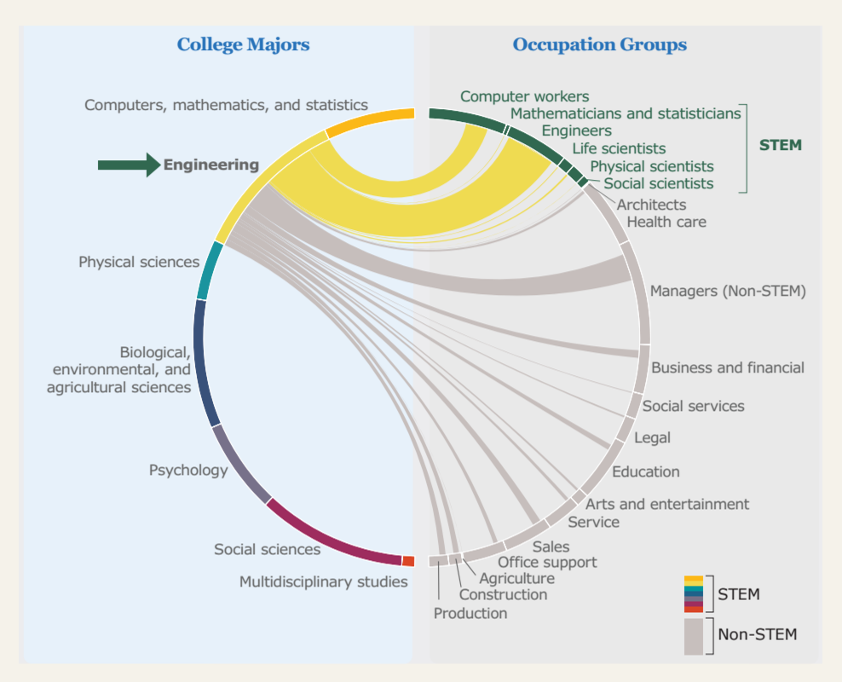
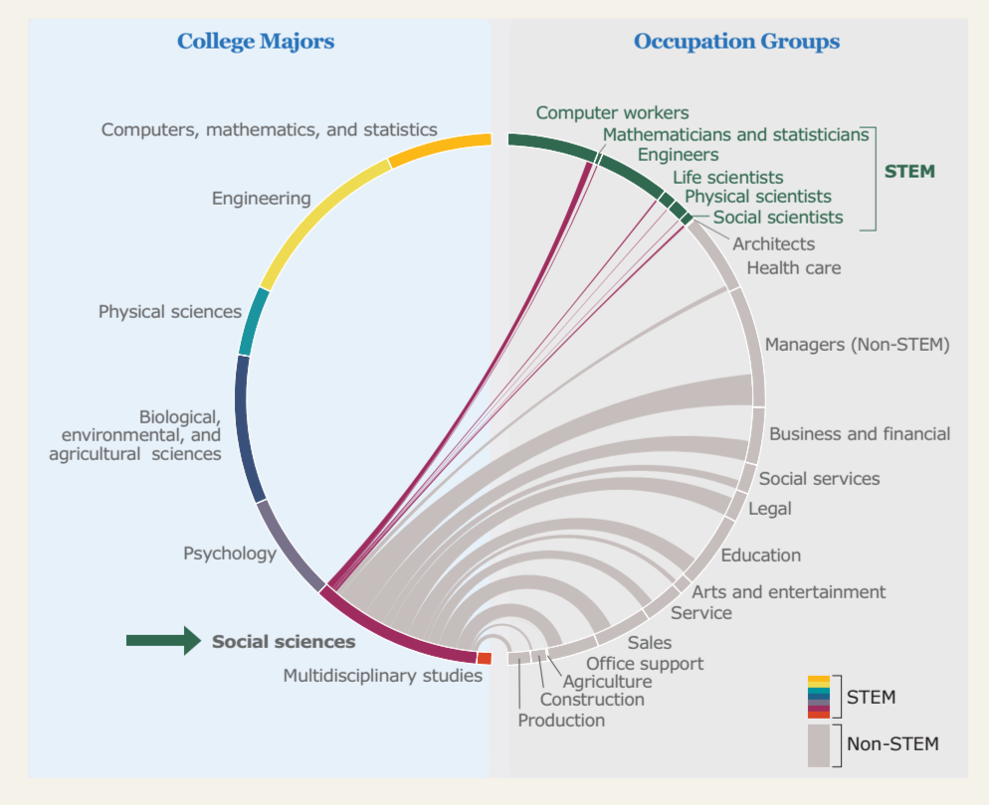
Traditional Pathway Map
SOURCE: U.S. Census Bureau, 2012 American Community Survey.
https://www.census.gov/dataviz/visualizations/stem/stem-html/
Notes:
chanida

Slide 46
Occupation Case Studies
We selected three STEM occupations with a diversity of traditional and non-traditional pathways
Dental Hygienist
Environmental Engineer
Junior Software Developer
Notes:
hannah
overview of each of these
reason for choosing just a few occupations vs. mapping all of stem:
making the data discovery and analysis more manageable
chose these occupations because they provided the diversity of traditional & non traditional pathways
We define “traditional” STEM pathway to involve entering a 4-year college out of high school, graduating college with a STEM degree, and then going to work in that field
“Non-traditional” STEM pathways
Online training
Sub-baccalaureate education
Vocational training
Dental hygienist and environmental engineer as occupations have higher proportions of women
Dental hygienist
Non-traditional STEM pathways
Environmental engineer
Traditional STEM pathways
Junior software developer
Possible interesting mix of people coming from both traditional and nontraditional pathways

Slide 47
Data Discovery
The data discovery process involved documenting and evaluating approximately 20 different data sources
Data sources we evaluated include
Surveys: Integrated Postsecondary Education Data System (IPEDS), Occupational Information Network (O*NET), Occupational Employment Statistics (OES), Scientists and Engineers Statistical Data System (SESTAT), NCES Education Longitudinal Study (ELS)
Resume and Job Websites for potential web-scraping: linkedin.com, indeed.com, github.io
Snapshots of non-traditional STEM education, such as online learning: edX, Coursera, other certification programs
Notes:
hannah
Documented and evaluated approx. 20 data sources as potential resources for our analysis
We assessed them across a set of factors, such as accessibility, applicability to project goal, and unit of analysis
Examples:
Listed in the ppt
Mention each bullet and give an example

Slide 48
Selected Data Sources
Data Source | Description | Unit of Analysis | Potential Use
O*NET | Survey of workers by occupation | Occupation | Gathering knowledge, skills, and abilities of a specific occupation to create a mind map.
IPEDS | Survey of every college, university, technical, and vocational institution that participates in federal student financial aid programs | Institution | Generate trends of certifications and degrees awarded by gender and race/ethnicity in STEM fields from 2010-2014.
IPUMS | Integrated Census microdata and ACS survey data. | Individual | Analyze pathways between education level and occupation type by sex, race, and/or ethnicity.
NCES ELS | Survey of students who were high school sophomores in 2002. | Individual | Describe student transitions between high school, college, and careers.
Indeed.com | Job posting and resume website | Individual | Identify education and skill pathways; Identity employer expected skill and knowledge.
Coursera | Website offering online training courses | Training courses | Identify skills valued by employers for each occupation that can be acquired through taking online courses.
Survey of Allied Dental Association | Surveys that include descriptions on academic programs, admission requirements, and enrollment. | Individual | Provides data on total enrollment by age, gender, and ethnicity and compares different educational settings.
Notes:
hannah
Chose to explore these data sources further
They seemed the most promising
O*net
provides information about knowledge, skills, and abilities for all of the occupations
Gathering skills and knowledge to create a mind map
Survey Data
IPEDS, O*NET, OES, SESTAT, NCES
IPEDS: getting data on people who have gotten associate’s/ master’s degrees in STEM-fields
Website Data
linkedin.com, indeed.com, github.io
Scrape these websites to help us identify workforce skills

Slide 49
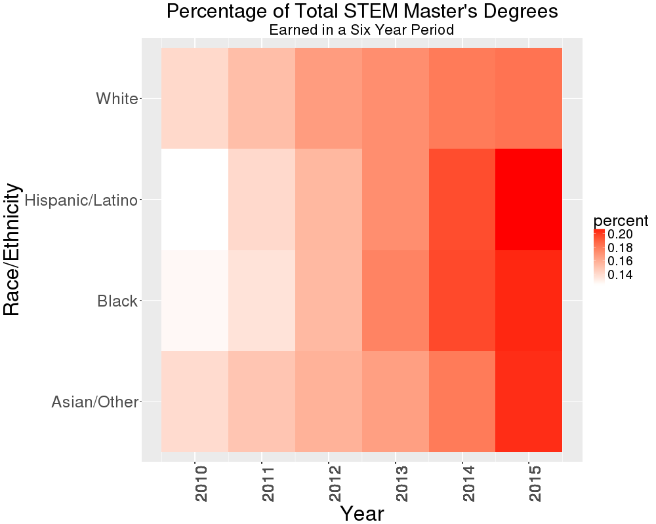
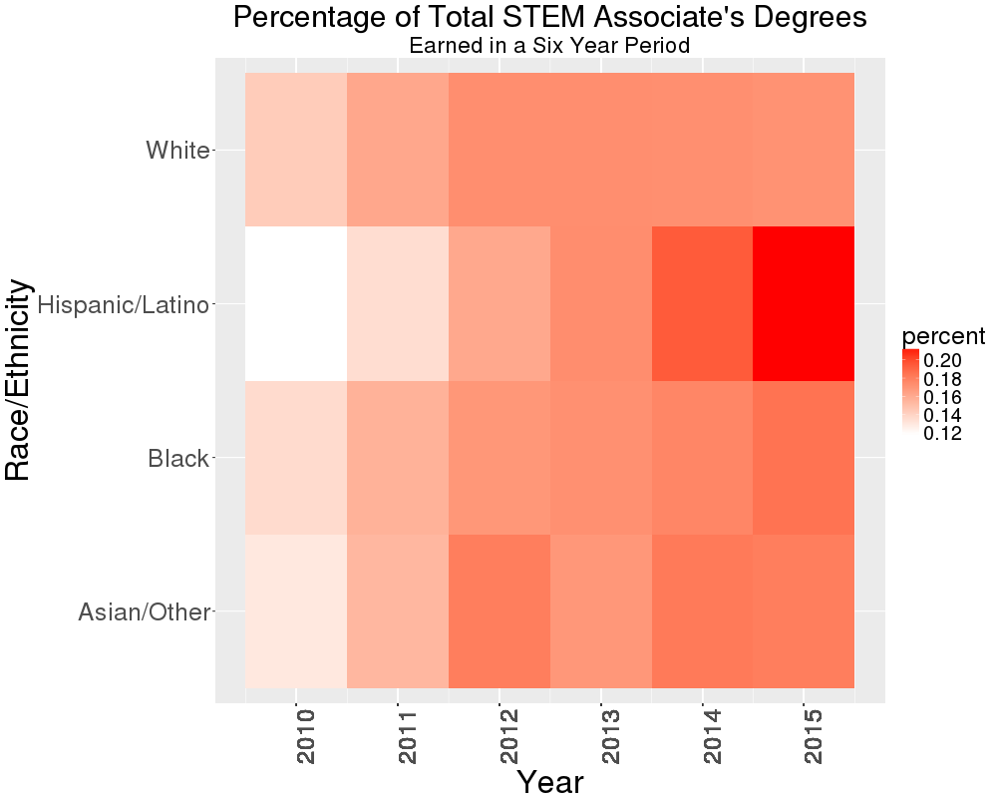
Trends in STEM Degrees by Race
NCES IPEDS Data Center
Notes:
ben
each panel represents the percent of degrees earned that year out of the entire 6 year period by race
Hispanic/Latino population earned more STEM master’s degrees and associate’s degrees in 2015 compared to 2010

Slide 50
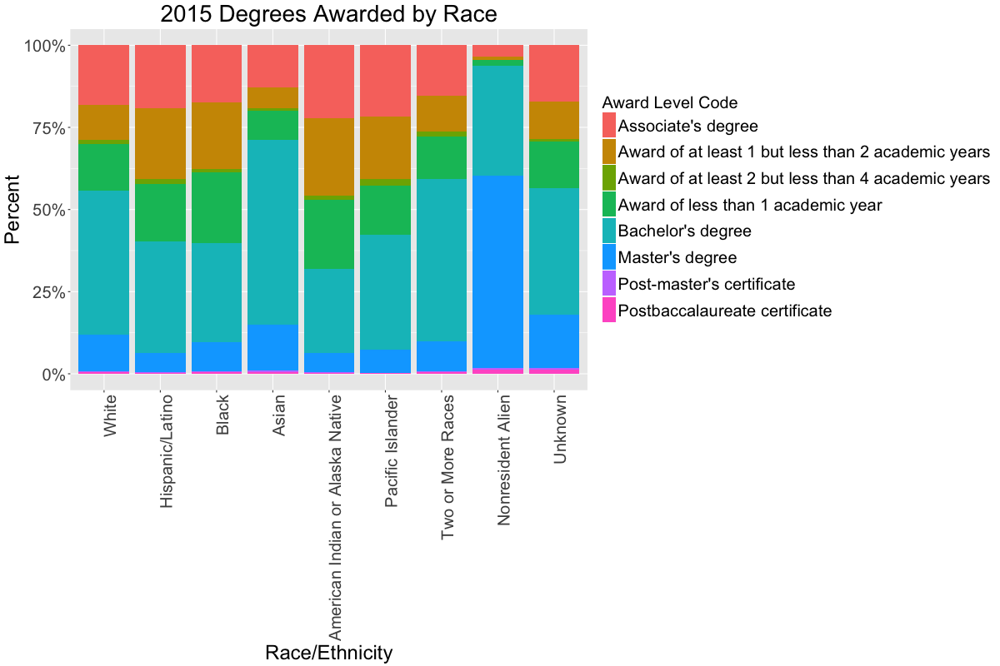
General Trends in STEM workforce
NCES IPEDS Data Center
Notes:
ben
ben
Nonresident alien population attends school in the US in a STEM field for bachelor’s, master’s (we will add PhD data to the final plot)

Slide 51
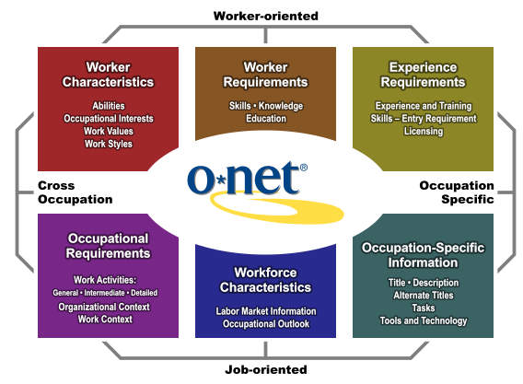
O*NET Content Model
https://www.onetcenter.org/content.html
Notes:
ben

Slide 52
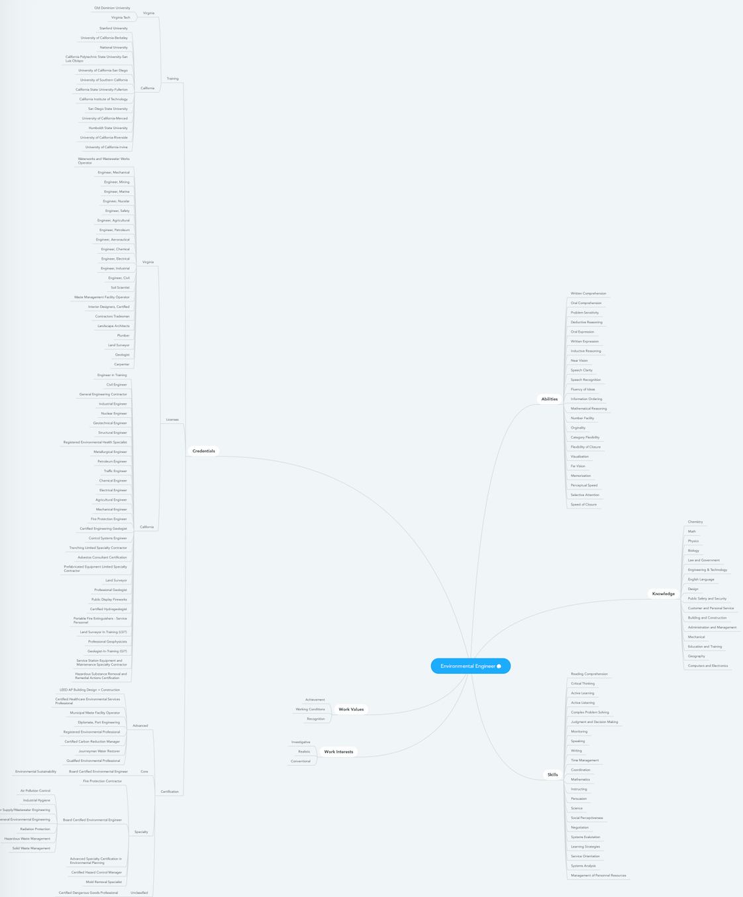
Mind Map for Environmental Engineer
Skills
Credentials
Knowledge
Work Values
Environmental Engineer
Work Interests
Abilities
Notes:
ben
Say we did all three
KSAs are developed by the employee through training, education, work experience, extracurriculars
An occupation’s work values and work interests must align with those of the employee.
Credentials may be required by an employer before offering employment and getting them after hiring may lead to promotion or a new job
Credentials includes training, licenses, and certifications

Slide 53
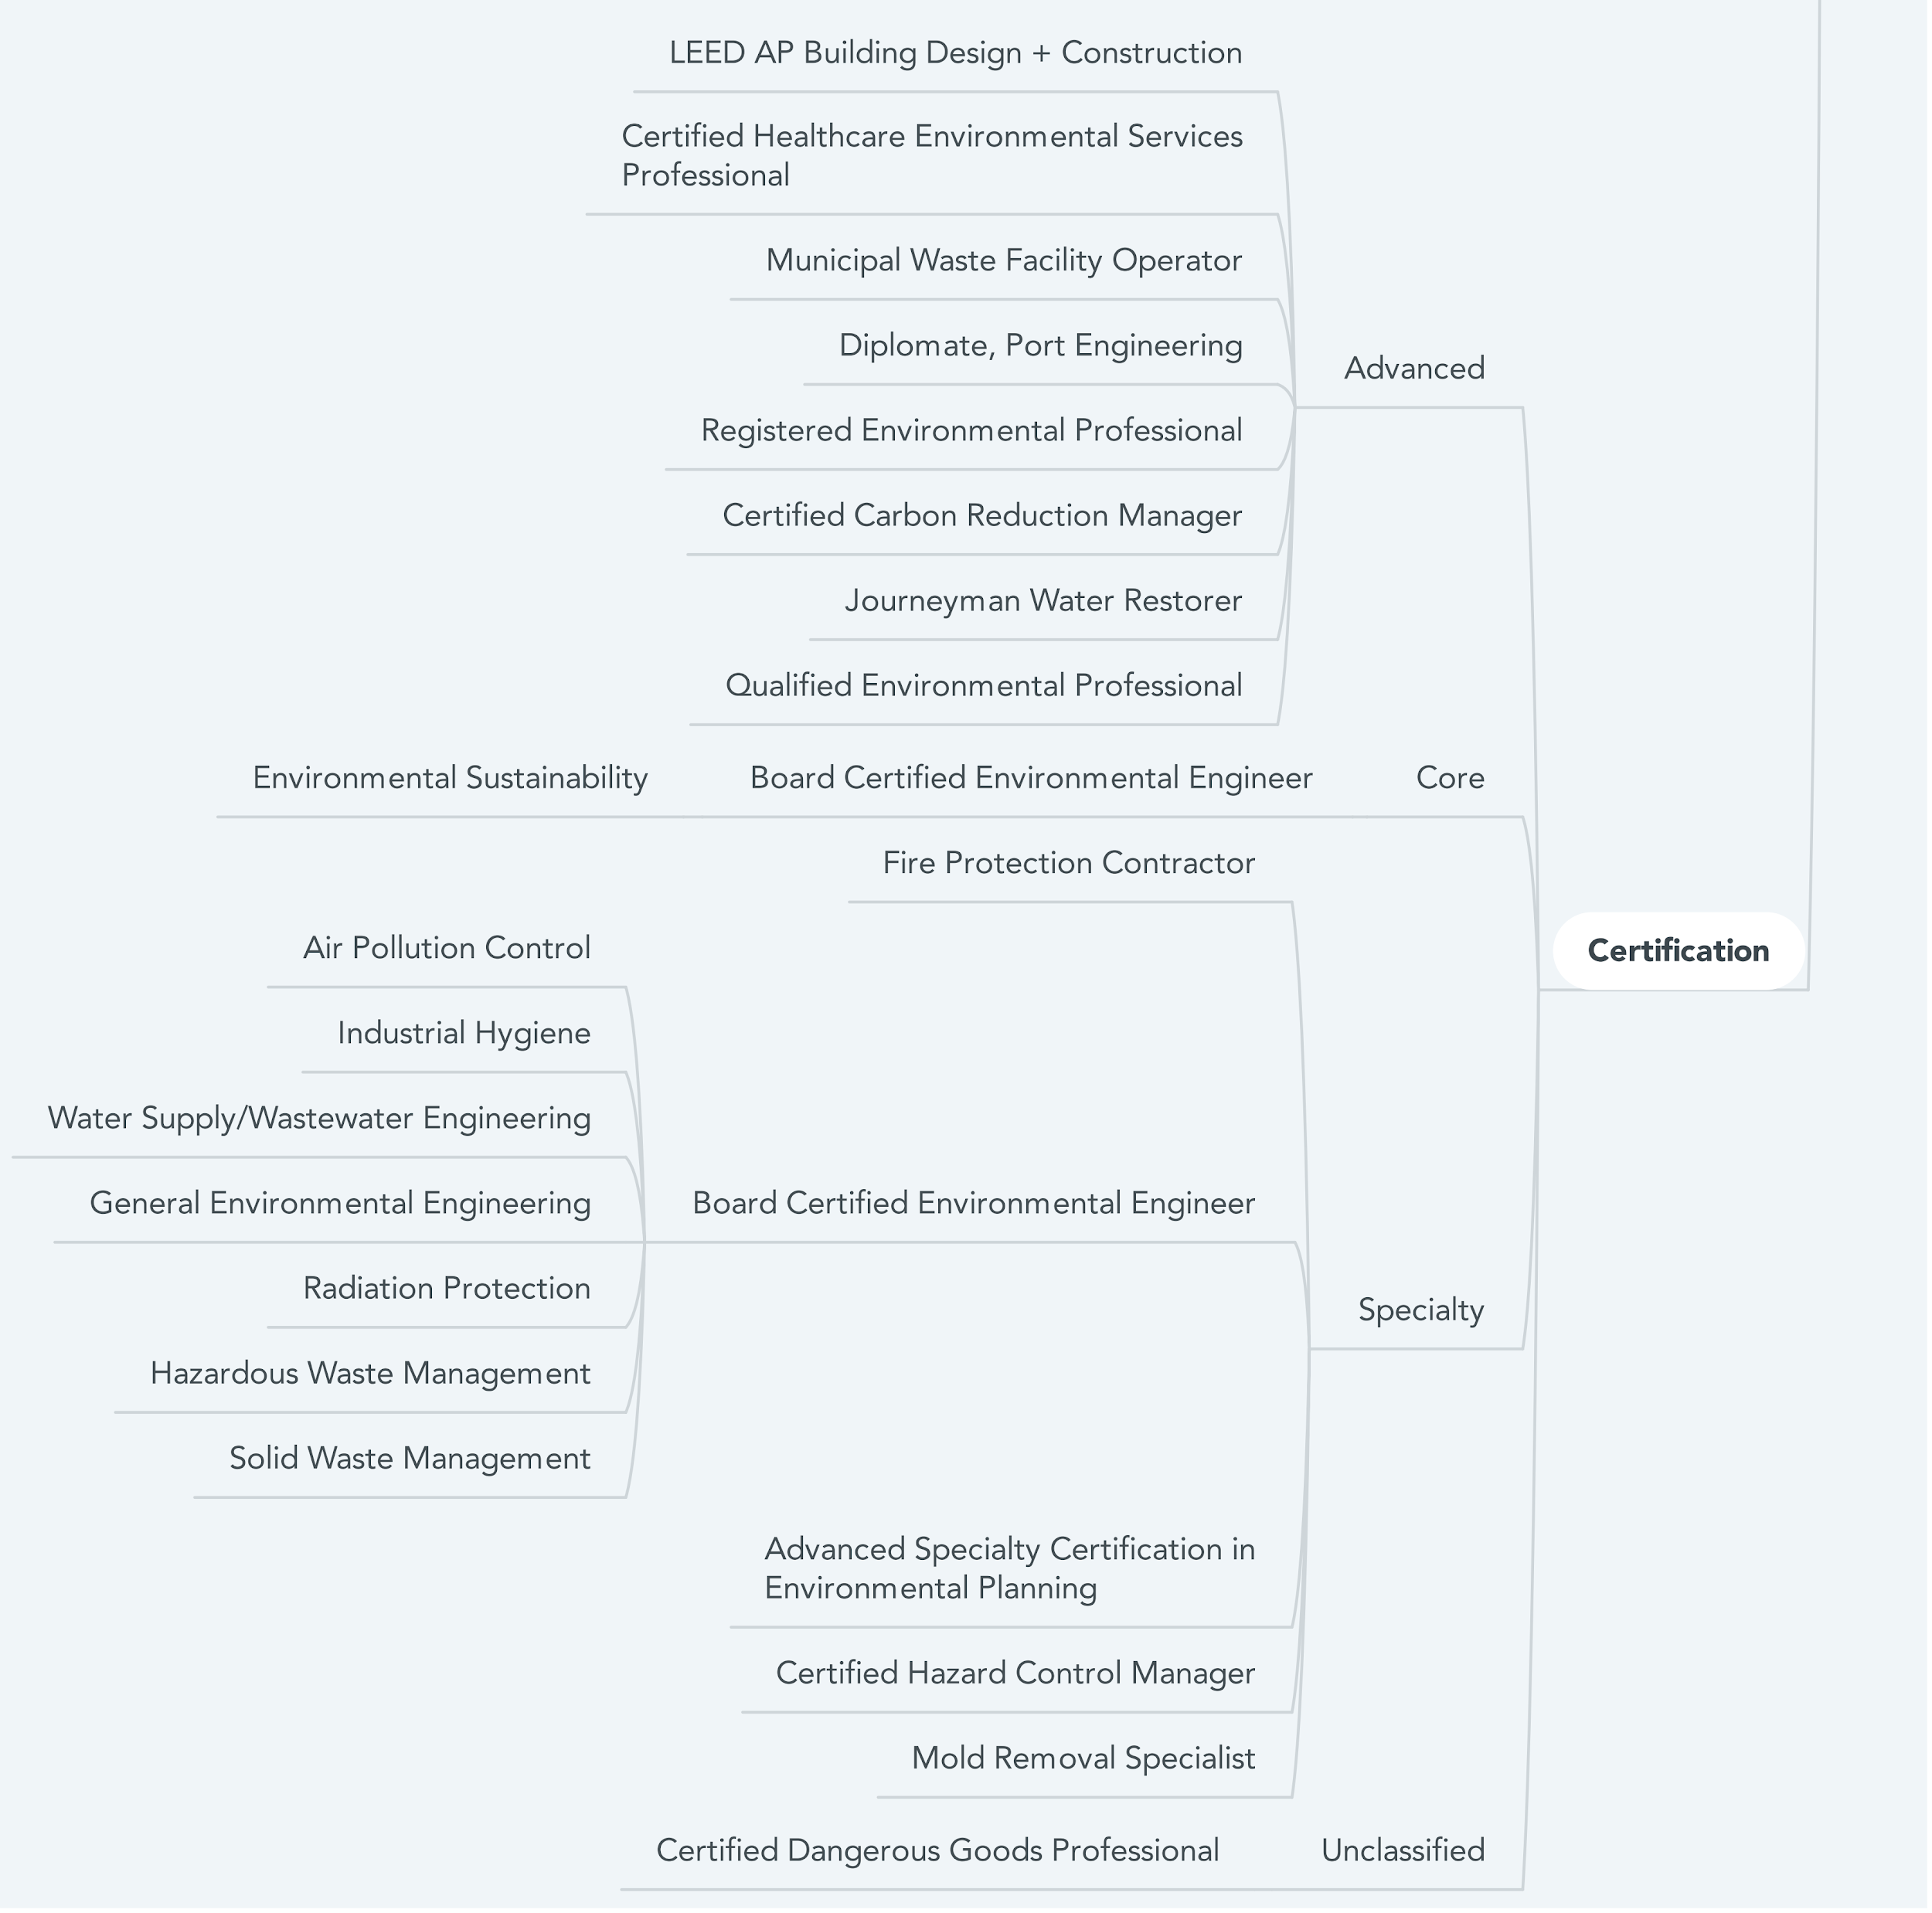
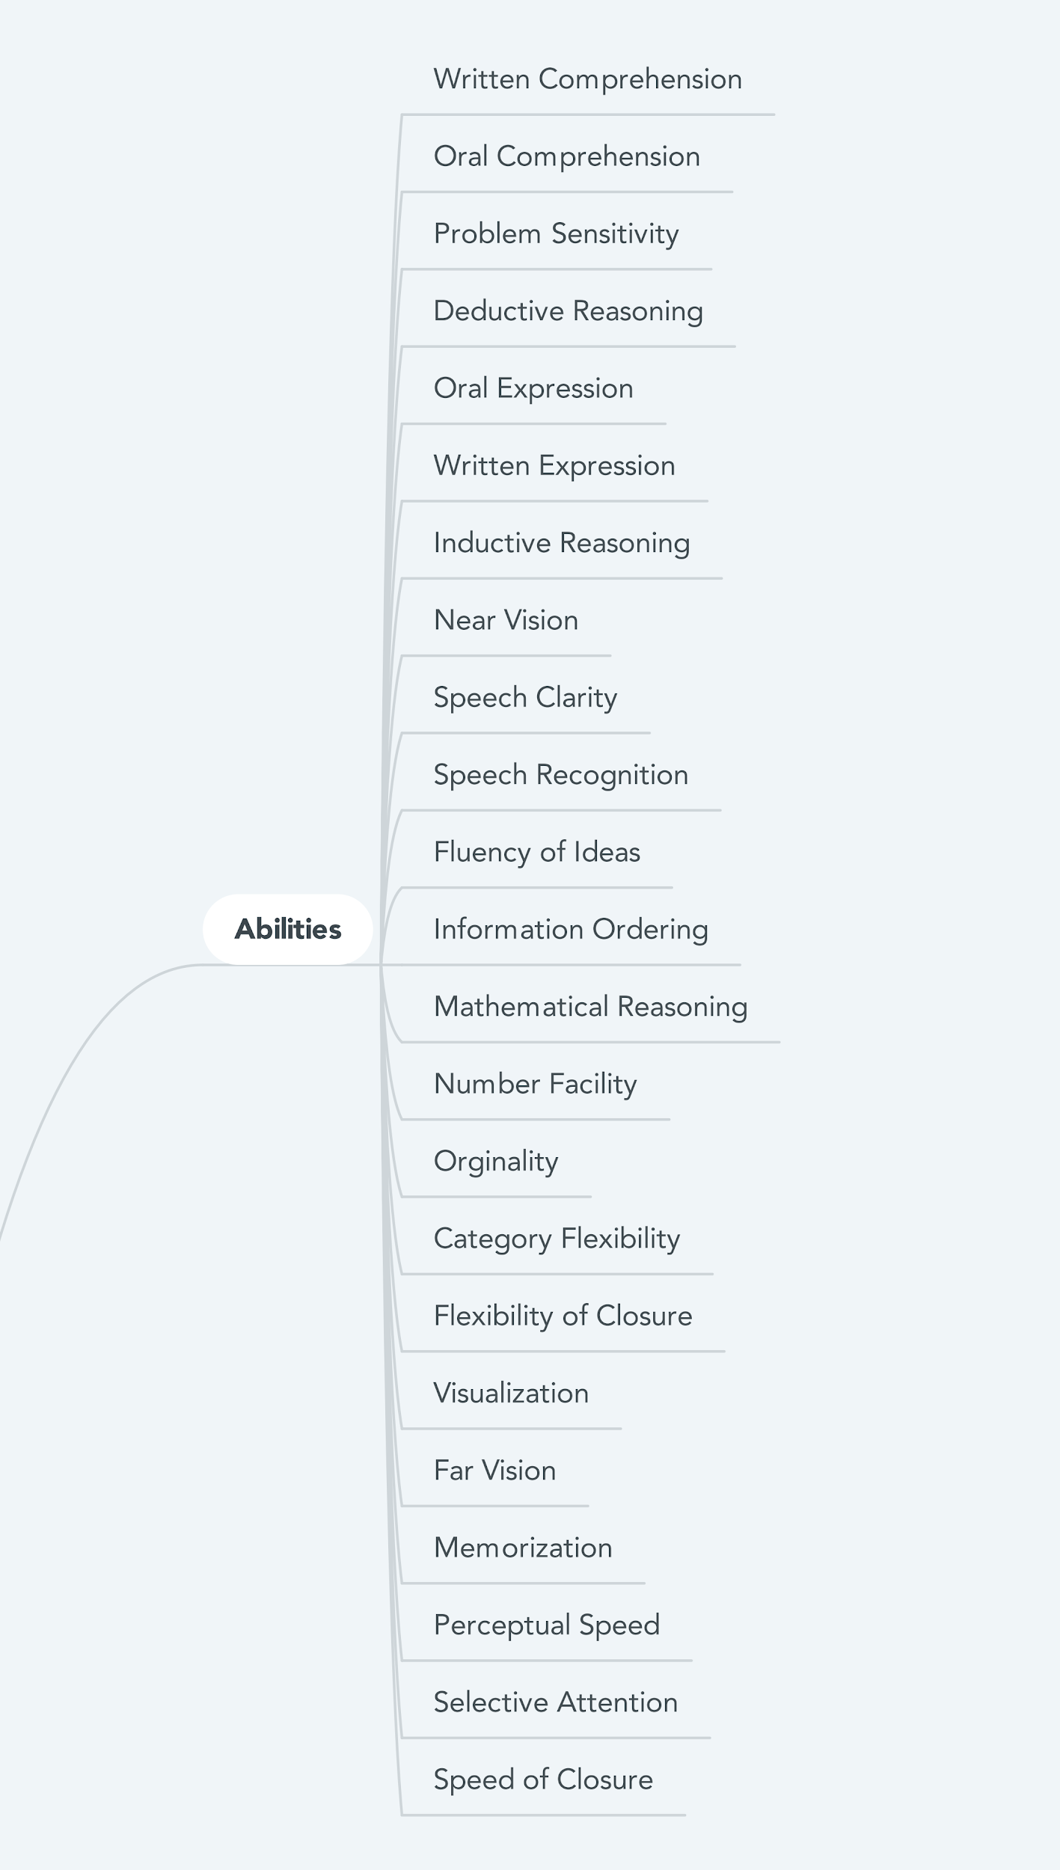
Mind Map - Snapshot
Notes:
ben
advanced certifications are typically processes. Municipal waste facility operator -- provisional cert + 6 months on the job + oral exam
abilities is a list

Slide 54
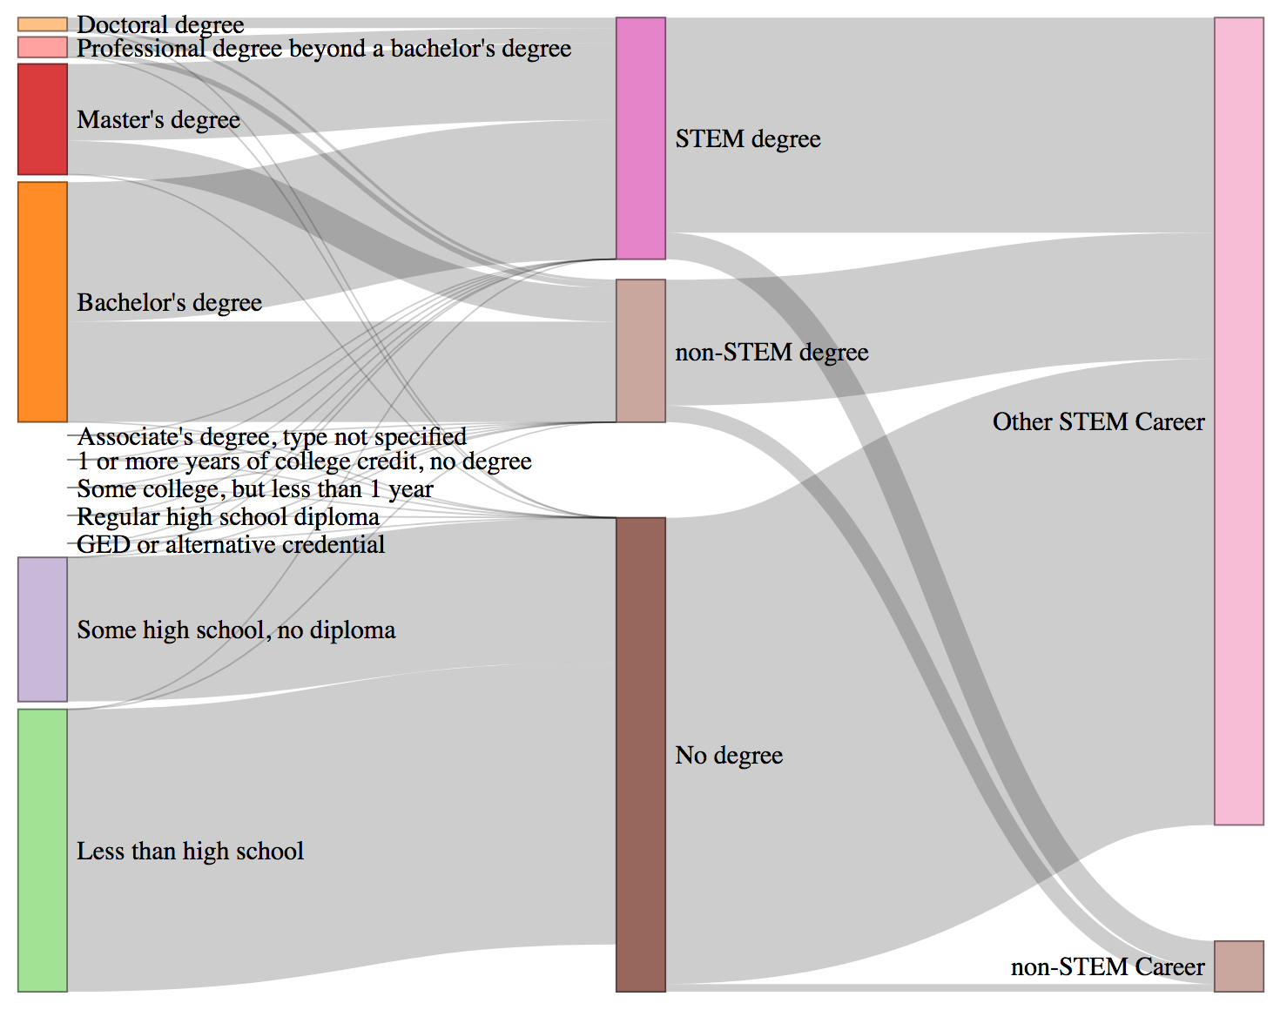
Employee Perspective:
Generating Pathways from Data
Integrated Public Use Microdata Service (IPUMS) is a publicly available source of harmonized Census, ACS, and CPS data.
At the individual level, this data is conducive to pathway mapping by education level, occupation type, and minority identity.
Notes:
Maddie
So far, challenges include
very broad definition of STEM (includes historians, teachers of all subjects, etc.)

Slide 55
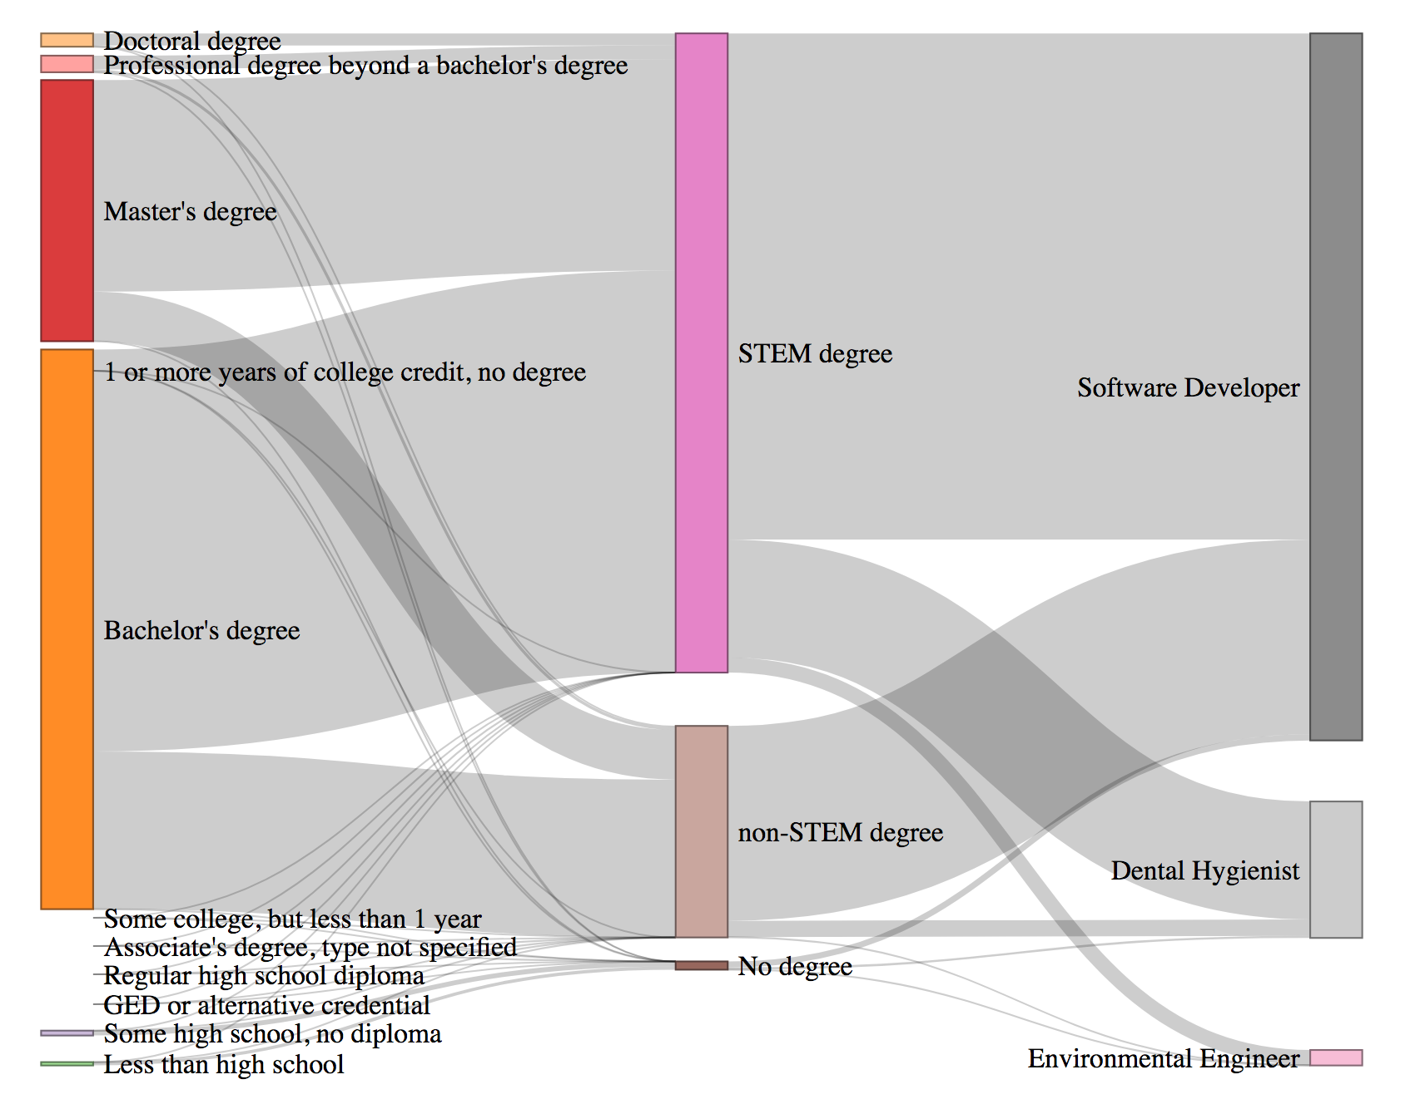
Employee Perspective:
Generating Pathways from Data
Next steps:
Focus pathway analysis on three selected occupations.
Identify which non-STEM fields attract STEM degree-holders (attrition).
Understand demographic patterns of STEM leavers and persisters.
Notes:
Maddie

Slide 56
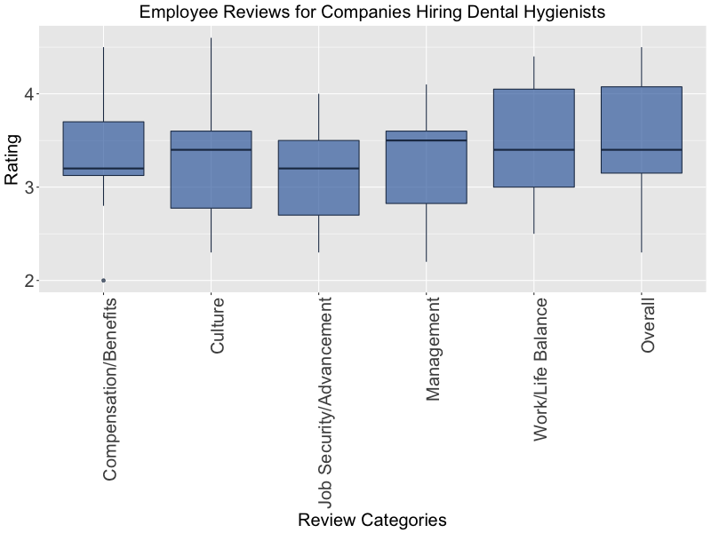
Employee Perspective:
Understanding the Workforce
Indeed is a job site that allows employers to post jobs and job seekers to post their resume, search for jobs, and provide company reviews
Coursera is an online training site developed in 2012 by two Stanford Computer Science professors who wanted to share their knowledge and skills
Title | Description | Skills
Python for Everybody Specialization | This Specialization will introduce fundamental programming concepts including data structures, networked application program interfaces, and databases, using the Python programming language…. | This course aims to teach everyone the basics of programming computers using Python. We cover the basics ….
Notes:
Maddie
Indeed:
The reviews are for 17 companies in Virginia that hire dental hygienists (there were 82 total companies, but only 17 had reviews)
Plot shows that the lowest ratings are in job security/advancement
Coursera:
We have webscrapped courses for software developers.
The table shows a snippet of the information for one of the courses scrapped

Slide 57
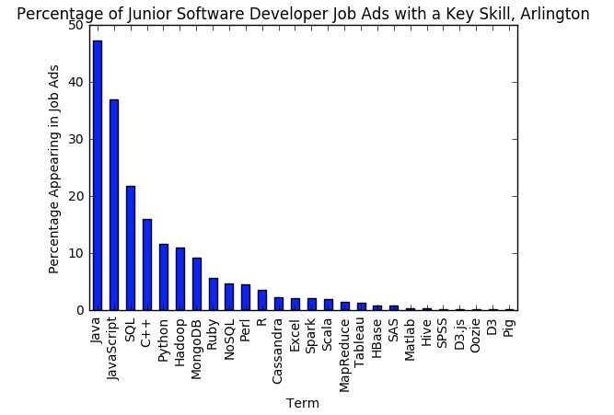
Employer Perspective:
Expected Knowledge and Skills
Key skills required/desired from companies currently hiring junior software developers (or similar)
We can compare these skills to those offered by Coursera and other institutions
Notes:
Maddie
Job ads on indeed.com within 25 miles Arlington, VA using the search term “junior software developer” (not all job ads pulled with have that exact title). Total of 633 job ads. This is an exploratory assessment of the percentage of job ads looking for a set of key skills.
We can compare this to the courses being offered by coursera (which can serve as a proxy for knowledge/skills attained by the workforce)

Slide 58
Steps Ahead
Use IPUMS to better understand pathways of STEM persisters and leavers
Pathways to STEM from non-STEM backgrounds
Patterns along race and gender lines
Use IPEDS to finalize general trends in the STEM degrees awarded
include PhDs
subset by gender
Continue analysis of web-scraped content (Indeed, oursera, etc.)
Map the knowledge/skills obtained by the workforce of our three occupations to the knowledge/skills desired by employers
Identify and document additional longitudinal surveys that may have data to support our STEM pathways or reveal new pathways (e.g., ECLS-K, B&B:08)
Notes:
Maddie
Baccalaureate and Beyond (Population: Bachelor degree recipients who were surveyed at the time of graduation, one year after graduation, four years after graduation, and ten years after graduation)
Early Childhood Longitudinal Study

Slide 59
Community Projects:
Alexandria - Equity
Team: Sayali Phadke, Daniel Wilkin, Ronnie Fresco
PI & Co-PI: Emily Molfino, Mark Orr
Sponsor: Alexandria City Government, Office of Performance and Accountability

Slide 60
Introduction
Equity is important for the well-being of citizens, and hence an important policy consideration
City of Alexandria striving towards combating issues of inequity in the city
‘Equity in Alexandria’ team would like to understand:
How is equity defined?
How can equity be measured?

Slide 61
Objectives of the project
Literature review on equity
Conceptualizing equity
How is it defined?
How is it measured?
Discuss the link between definitions of equity and data sources w.r.t. the City of Alexandria
Provide recommendation to the city government about data sources and a data portal

Slide 62
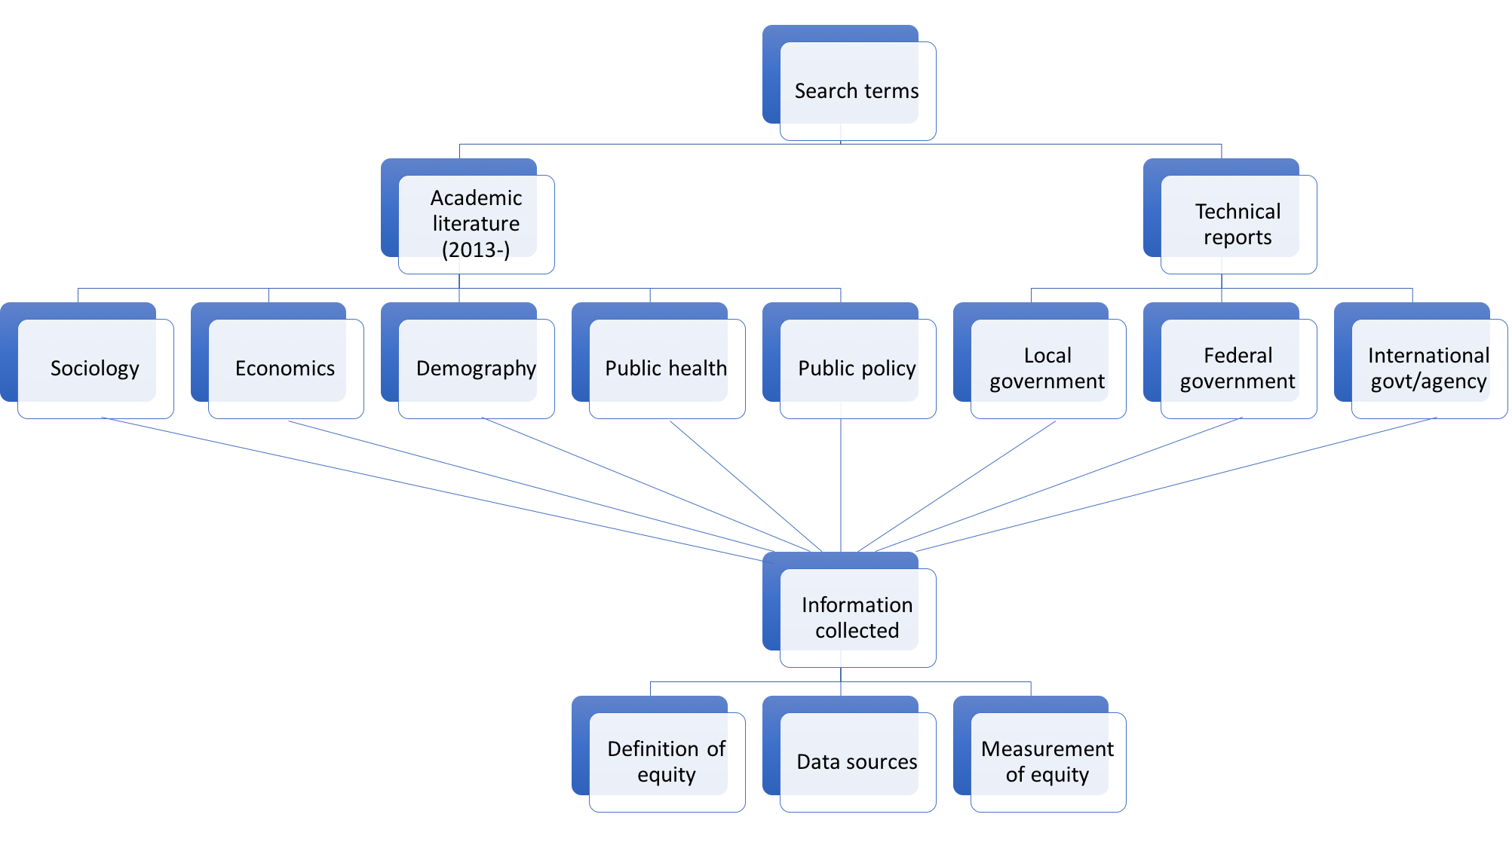
Methodology: literature review

Slide 63

Methodology: lit review (contd.)

Slide 64
Lit review: Output
Equity can be understood in its many forms:
Equity of access
Equity of distribution
Equity as achieved by inequality of treatment
Process equity
Equity can be measured in different ways:
Simple comparison of variables-of-interest across groups (education by race, driving privileges by age etc.)
Composite indices (e.g. Gini coefficient, Theil statistic etc.)
Other methods such as Principle of Proportional Shortfall, Expected Inequality-Averse model

Slide 65
Lit review: Output (contd.)
Equity is studied with respect to one aspect or a combination of various aspects:
Who you are: Age, race, gender etc.
What is provided: Transportation services, housing facilities etc.
What is available: Health, education etc.
What you can achieve: Employment etc.
Several reports focusing on city or county level equity:
King’s county, WA
Multnomah county, OR
Dane county, WI
Boston, MA
San Francisco, CA

Slide 66
Lit review: Output (contd.)
Several research groups aim to understand and measure equity, presented via a web-based interface:
http://nationalequityatlas.org
http://thrivingcities.com
Data sources
Administrative data from local, state, and federal level
Survey conducted by local government
Policy and planning documents

Slide 67
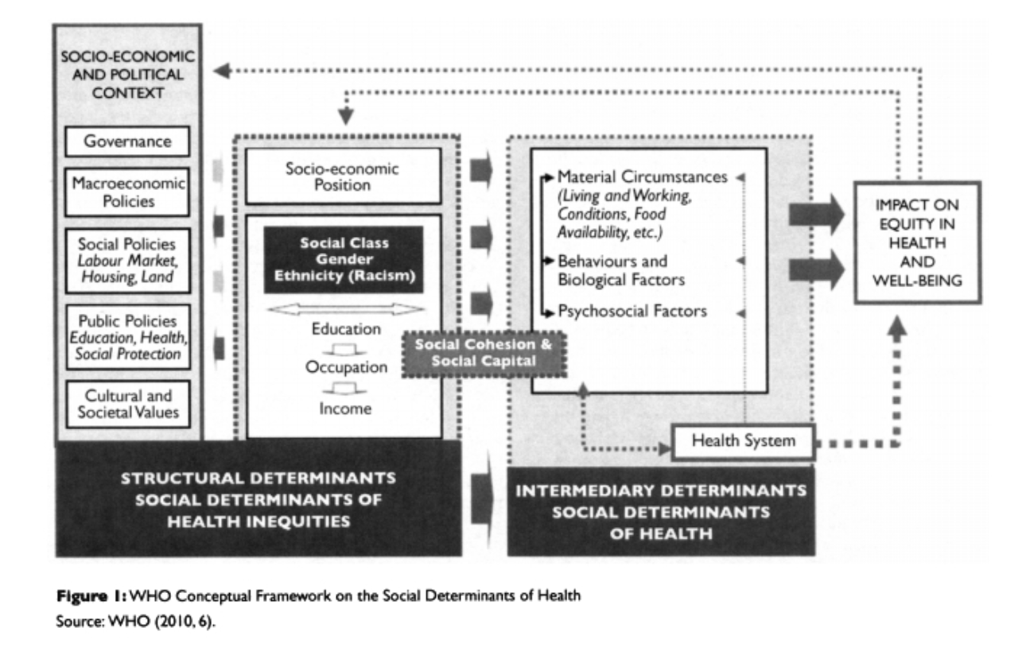
Equity in Health & Generalization
ALIMEZELLI, H., LEIS, A., DENIS, W., & KARUNANAYAKE, C. (2015). Lost in Policy Translation: Canadian Minority Francophones and Health Disparities. Canadian Public Policy / Analyse De Politiques, 41, S44-S52.
Notes:
Most frequent, most recent, most prominent research on equity seems to be in the area of health equity. This infographic, although specified as the framework for social determinants of health, i believe it can be generalized to social determinants of other forms of equity, or the lack of it thereof, as well.

Slide 68
Baseline measure
Calculate baseline measure of racial equity in Alexandria
Data source:
ACS does not provide cross-tables with race variable
Use data from NHGIS (National Historical Geographic Information System)
Look at racial breakdown of key variables such as education, income, household details, health status etc.
Geographical levels:
Zip codes
Block groups
Visualize for the most recent time period for which data is available
Compare with residents’ sentiment as understood by the Alexandria Resident Survey

Slide 69
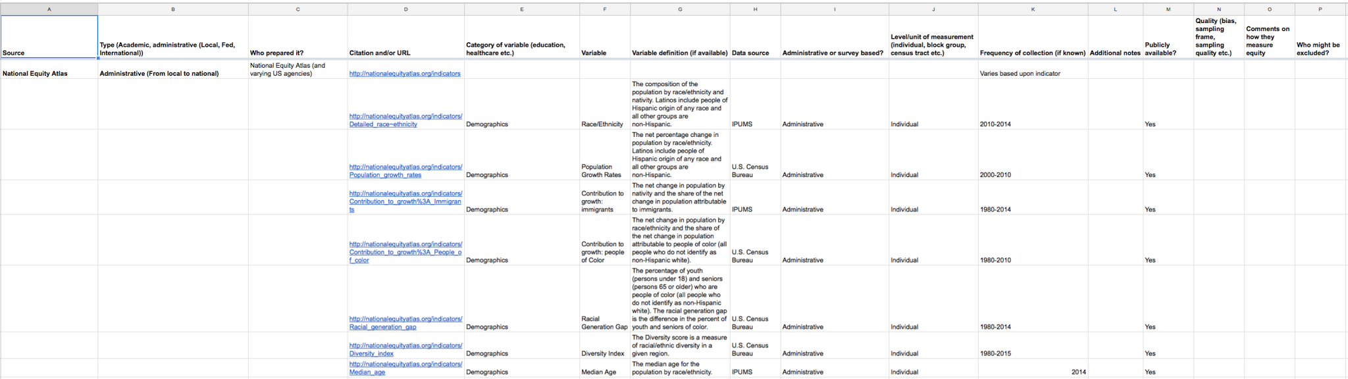
Deliverables
Literature review resulting in annotated bibliography
Extensive data bibliography
Baseline on racial equity in Alexandria, referenced with results from the Alexandria Residents’ Survey

Slide 70
Community Projects:
Fairfax - Youth Projections
Team: Zarni Htet, Chanida Lerdritsomboon, Eirik Iversen, Ben J. Swartz
SDAL: Josh Goldstein and Stephanie Shipp
Sponsor: Fairfax Health and Human Services (HHS) - Michelle Gregory, Sophia Dutton, Linda Hoffman

Slide 71
Project Description
Fairfax Health and Human Services (HHS) is interested in developing long-term population and economic forecasting capabilities
Research Questions
Which HHS programs and services may be affected by changes in population size, behaviors, and demographic makeup?
What current and future trends in demographics, housing, and other factors would inform the models to predict changes in their programs?
What are trends in the data that warrant more investigation?
Notes:
Chanida
using local, state, and federal data to set their short-term planning activities
3. e.g., Why are kids engaging in less and less physical activity?
·

Slide 72
Specific Research Questions
Are mental health services accessible to address depression, anxiety, and eating disorders?
Are mental health services available?
Notes:
Chanida
Mental Health Service availability: Ben’s scraped data, and SAMHSA

Slide 73
Literature Review
What is Mental Health Disorder?
According to the World Health Organization (WHO), a mental health disorder is:
behavioral/psychological,
of clinical significance,
accompanied by a concomitant distress and/or a raised risk of death, or an important loss of freedom
involves an unexpected cultural response to any situation
Source:https://www.ncbi.nlm.nih.gov/pmc/articles/PMC556080/
Notes:
Chanida -
The rise of mental health disorder and mental health problems have been driven by social change, which includes disruption of family structure, the growth of youth unemployment, and the increase in educational pressures

Slide 74
Literature Review
Mental health problems and disorders in adolescents
Problem or disorder | Prevalence (%)
Common
Depression | 3-5
Anxiety | 4-6
Attention-deficit/hyperactivity disorder | 2-4
Eating disorders | 1-2
Conduct disorder | 4-6
Substance misuse disorder | 2-3
Source: https://www.ncbi.nlm.nih.gov/pmc/articles/PMC556080/
Notes:
Chanida - how often it occurs: prevalence

Slide 75
Literature Review continued..
Service availability barriers
Physical Location
Low visibility for anonymity
High visibility for increased awareness
Comfortable environment for patient
Potential Solutions: Outreach programs, Recreational activities
Cultural Barriers
The idea of what mental health is will vary from culture to culture
Stigma towards receiving care
Administrative Barriers
Operating hours conflict with schedule of the clientele
Inside school hours
what is the appropriate time to request mental health care?
Source: https://www.ncbi.nlm.nih.gov/pubmed/24898523
Notes:
NOTE- We had many other sources of data for these slides?
Chanida
mental health barriers to serivce availablilty, how discrete do u wanna be, private vs. public.
-disgrace of recieving the services/care
-cost, time, insurance

Slide 76
Literature Review continued..
Los Angeles Unified School District and the San Francisco School District Mental Health Services
Similar to the mental health services provided by Fairfax County
Wellness/prevention services, community based organizations, intervention programs, Medication support services, etc.
Barriers to mental health in Fairfax county
Inconsistent/incomplete information with parents, mostly regarding insurance coverage, available providers, etc.
Lack of a coordinated, cross system training curriculum. Also, low income families lack transportation, health insurance and other resources that inhibits them from accessing these mental health services.
Notes:
Sources? Need for poster
Chanida
In conclusion, this information allows us explore more accessible health options for youth, such as community groups, therapists, psychologists, and we will try to map them in such a way to improve the accessibility of them to families.
Sources:
San Fran Health Network: http://www.sfhealthnetwork.org/primary-care-3/community-health-programs-for-youth-chpy/
Edgewood: http://www.edgewood.org/whatwedo/school/?referrer=https://www.google.com/
San Francisco Wellness Initiative program: https://sfwellness.org/our-program/results-impact/
Youth Risk Behavior of San Fran Unified School District (SFUSD)
California Healthy Kids Survey from the San Francisco Unified School District
Los Angeles Unified School District: School Mental Health: http://achieve.lausd.net/smh
Interim status reports and recommendations on Fairfax County Youth Behavioral Health Serviceshttp://www.fairfaxcounty.gov/living/healthhuman/reports/youth-behavioral-health-service-report.pdf
sources:

Slide 77
Data Discovery
American Community Survey (ACS)
Characterize and identify areas of low mental health accessibility
Fairfax Community Health Dashboard
Identifying possible relation between community indicators to predict mental health disorder trends
Web Scrape of Psychology Today
Fairfax Youth Survey
Star - selected sources
Notes:
NOTE - WHAT HAPPENED TO THE INITIAL DATA SOURCES - PRIMARILY FEDERAL SURVEYS?

Slide 78
Data Discovery
Other data sources explored
Substance Abuse and Mental Health Services (SAMSHA) -
Mental Health Facilities Data
Virginia Department of Education (VDOE)
Fall enrollment - characteristics by school
On time graduation rates by school
Dropout rates by school

Slide 79
Topics from Survey
Indicators examined from Fairfax County Youth Survey:
cyberbullying victim
cyberbullying aggressor
extracurricular activities available
extracurricular activities regularly
food insecurity
fruit and vegetables consumption
gratitude
“how much do you agree with the statement: ‘I have much in life to be thankful for’ ?”
parent help available
physical activity daily
physical activity none
sleep 4 hours or less
sleep exactly 6 hours
depression
suicide consider
suicide attempt
high stress
adults talking:
“There are lots of adults in my neighborhood I could talk to about something important?”
binge drinking
bullied victims in school
bullied victims not in school
cigarette usage
marijuana usage
Source: http://www.fairfaxcounty.gov/demogrph/youthpdf.htm

Slide 80
Survey Question Definitions
Depressive Symptoms:
Those who felt so sad or hopeless almost every day for two weeks or more in a row during the past 12 months
Food Insecurity:
Those who go hungry because there was not enough food at home during the past 30 days
Physical Activity None:
Those physically active for less than 60 minutes during the past 7 days
Parent Help Available:
Those who had a personal problem that could ask their parents for help
Extracurricular Regularly:
Those who participated in school or non-school-based activities after the regular school day ended

Slide 81
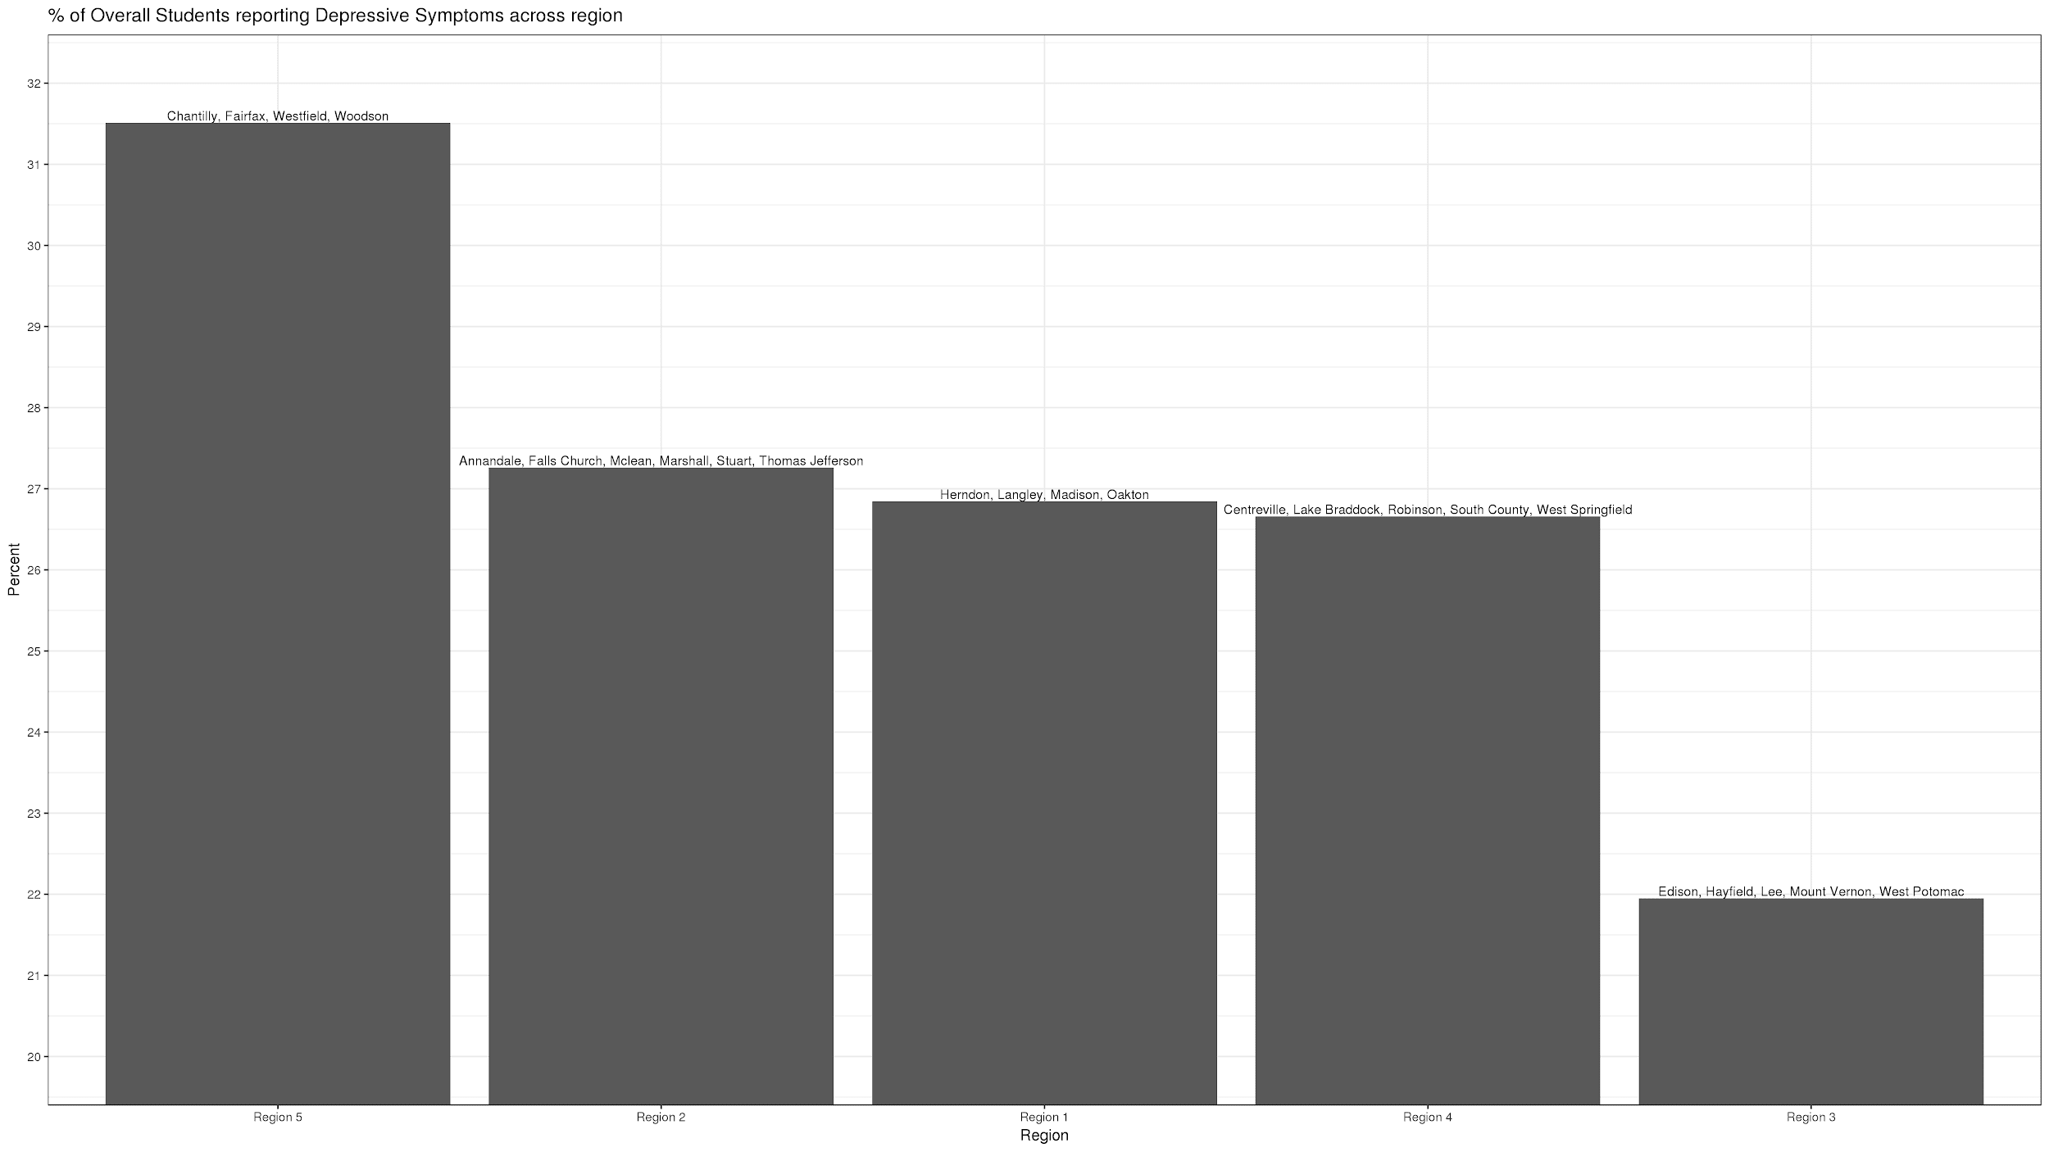
% Students Reporting Depression by Fairfax School Regions
List of High Schools by Region
Region 5 - Chantilly, Fairfax, Westfield, Woodson
Region 2 - Annandale, Falls Church, McLean, Marshall, and Stuart Pyramids + Thomas Jefferson High School for Science
Region 1 - Herndon, Langley, Madison, Oakton, and South Lakes
Region 4- Centreville, Robinson, South County, West Springfield, Lake Braddock
Region 3 - Edison, Hayfield, Lee, Mount Vernon, and West Potomac
5 2 1 4 3
REGION
Notes:
-fairfax county wants to do an intervention, dont want one intervention at one school, so they r going to implement an intervention on the geographic regions so they dont have to spread their resources thin over the county.
-big idea: why it is important to look at it as a region grouping as well along with heat maps which grouped by HS boundaries. this is more broad.
by geographic region
-Average percent of depressed students in the region
-found this by taking the number of depressed students in each HS and adding them up according to region, then dividing by the total number of eligible surveys in each region.
-of all the surveys in region 2, 28% of surveys indicated depressive symptoms
-data itself was given as percents in the youth survey
-eligible surveys: column in the data (Youth survey data)

Slide 82
Fairfax Youth Survey - Selected Results from 2014-2015
For those with high % of depressive symptoms (relative to other high school pyramids), and other factors that may be related
High School pyramid | Demographic | Depressive Symptoms (%) | Food Insecurity (%) | No Physical Activity (%) | Parent Help Available (%) | Extra- curricular Regularly (%)
FAIRFAX | Overall | 32 | 25 | 12 | 76 | 72
LEE | Overall | 29 | 28 | 17 | 76 | 58
MOUNT VERNON | Overall | 28 | 31 | 19 | 77 | 59
Source: http://www.fairfaxcounty.gov/demogrph/youthpdf.htm
Notes:
Note: This table does not make sense if you look at the prior chart - this says that Fairfax and Lee have the high percent of depressive symptoms but they are in a region with the lowest % of students with depression?
NOTE: WHAT DO THESE NUMBER MEAN? The findings are not clear. Are these percents of students with depressive symptoms, food insecurity, no physical activity, etc. ?
NOTE: Round to zero decimals. Level of specificity not needed for presentation.
NOTE: These are not trends. You are showing one year of data - cite source and year of data.
make your own table

Slide 83
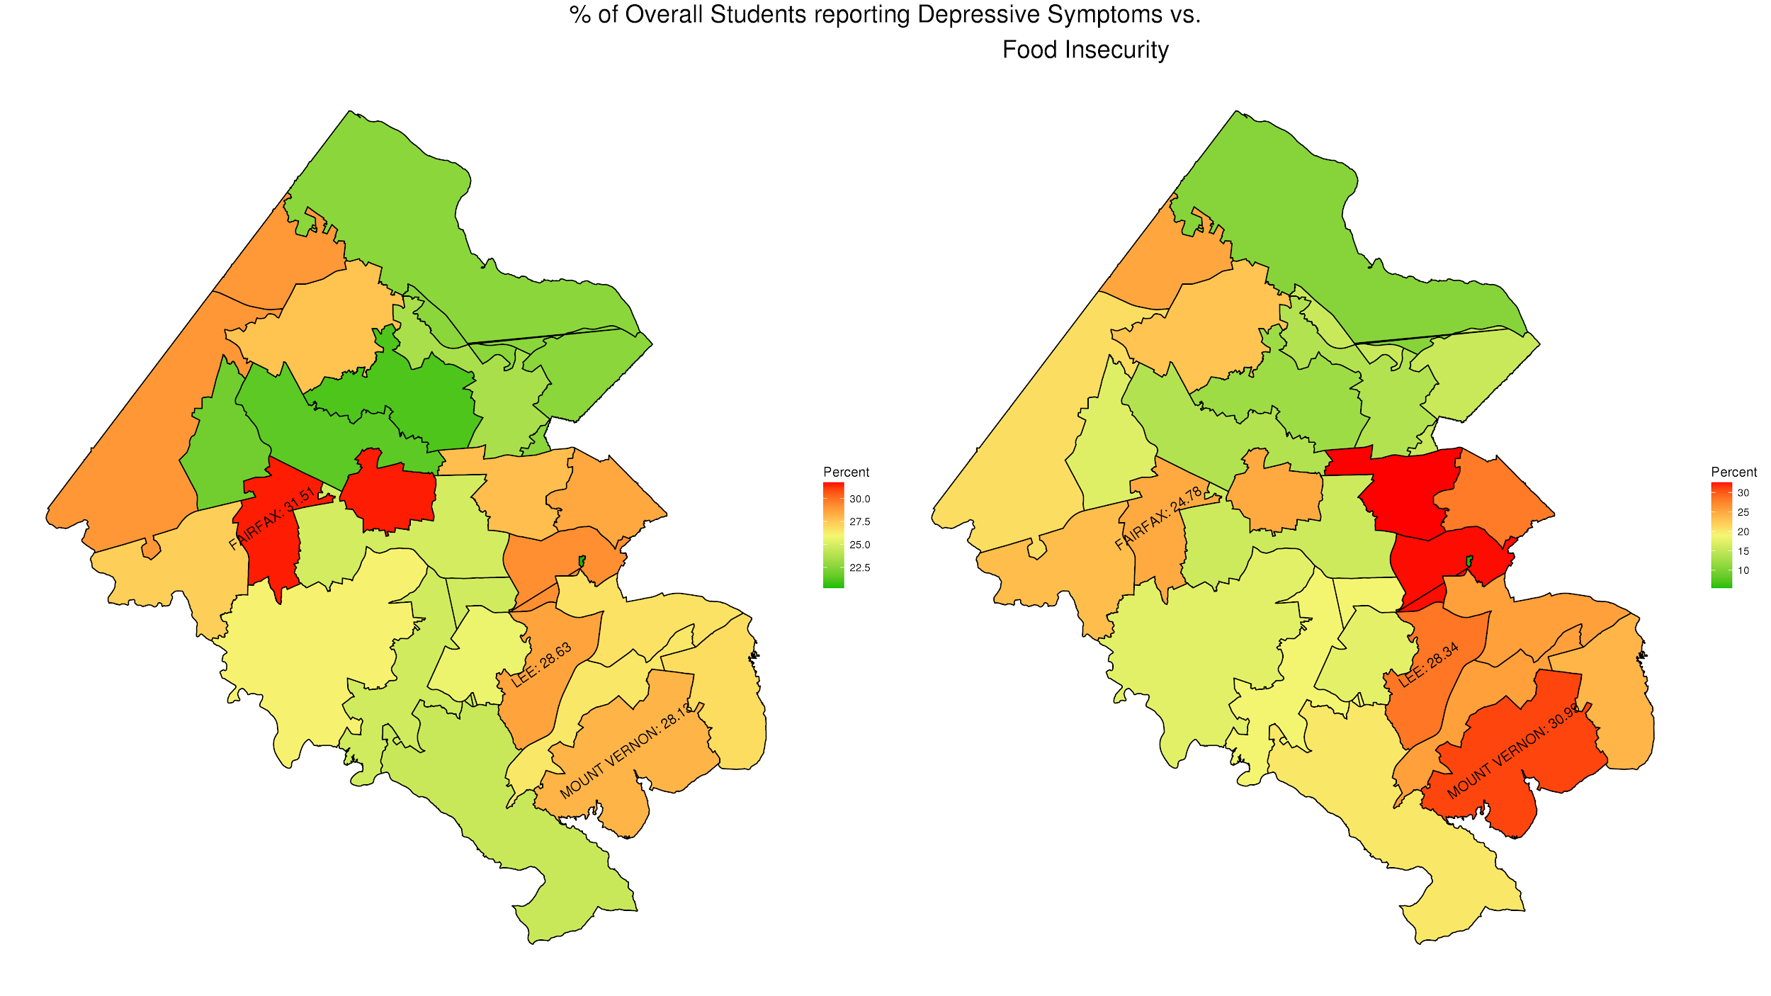
% Students Reporting Depressive Symptoms (left)
and % Students Reporting Food Insecurity (right)
Shades of green = relatively good (light) to good dark)
Red = bad; e.g. high % of students with depressive symptoms
Shades of gold = in the middle from light gold (top middle) to dark gold (bottom middle)
Each area on the map is a high school pyramid boundary that includes the high school, middle schools, and elementary schools for that boundary.
Notes:
Legend is unreadable. Need to make legend be much larger. Then can crop out the right hand legend.
Let’s talk about what to highlight for poster.

Slide 84
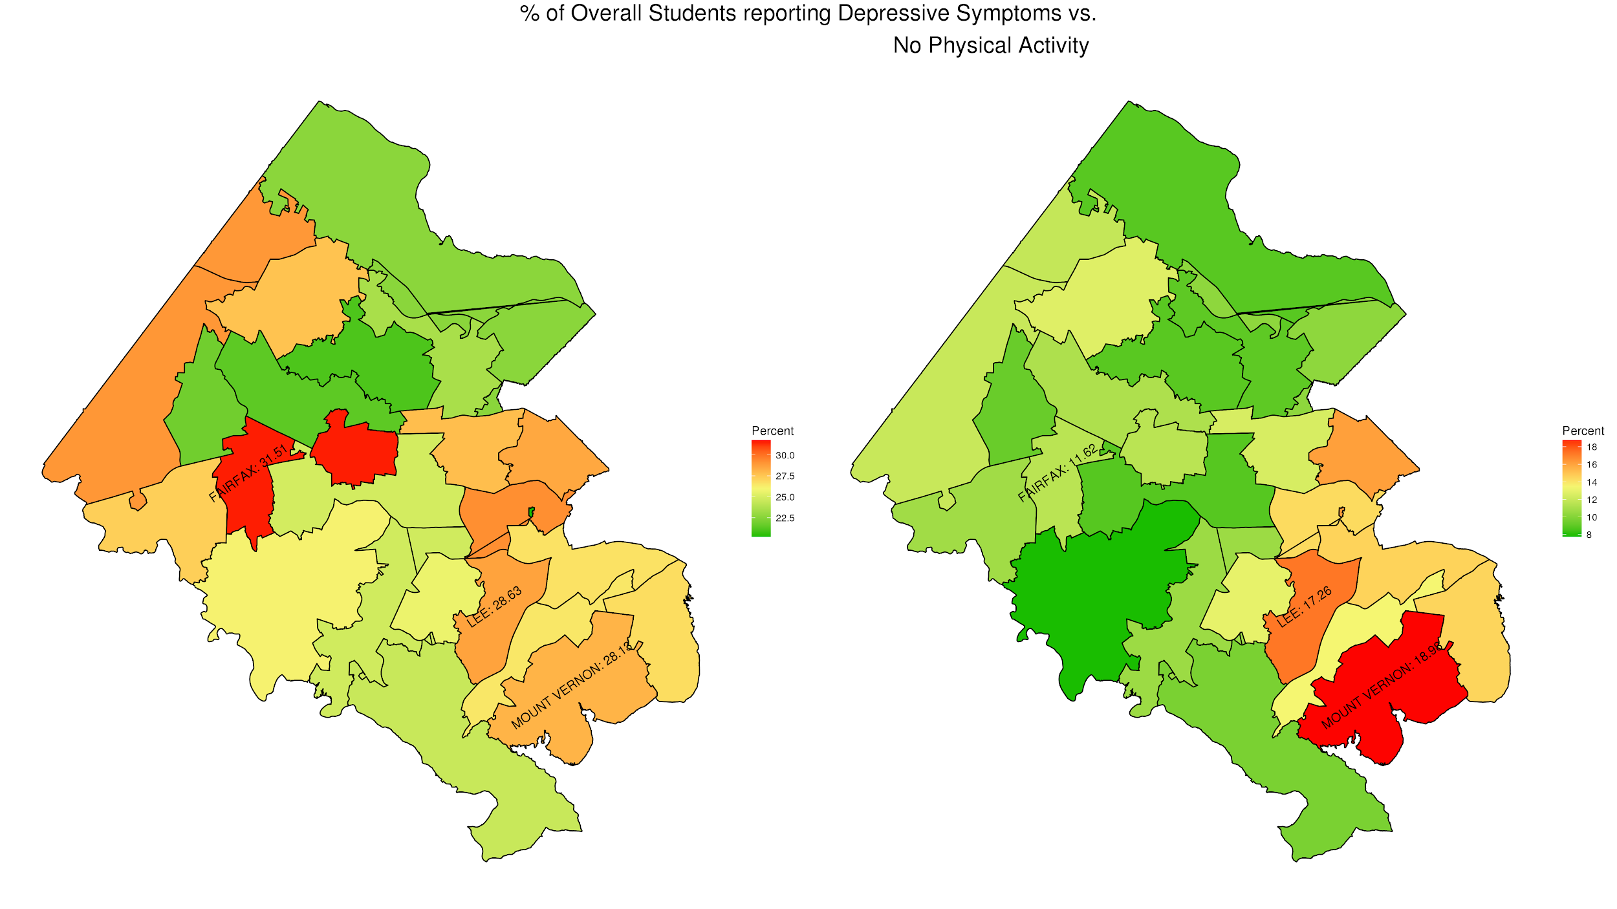
% Students Reporting Depressive Symptoms (left)
and % Students Reporting Physical Activity (right)
Shades of green = relatively good (light) to good dark)
Red = bad; e.g. high % of students with depressive symptoms
Shades of gold = in the middle from light gold (top middle) to dark gold (bottom middle)
Each area on the map is a high school pyramid boundary that includes the high school, middle schools, and elementary schools for that boundary.

Slide 85
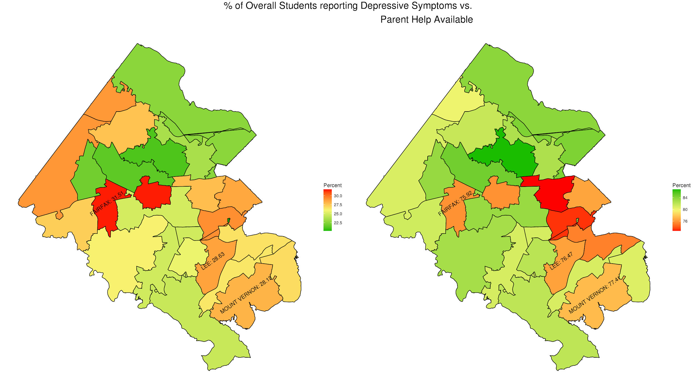
% Students Reporting Depressive Symptoms (left)
and % Students Reporting Parents’ Help Available (right)
Shades of green = relatively good (light) to good dark)
Red = bad; e.g. high % of students with depressive symptoms
Shades of gold = in the middle from light gold (top middle) to dark gold (bottom middle)
Each area on the map is a high school pyramid boundary that includes the high school, middle schools, and elementary schools for that boundary.

Slide 86
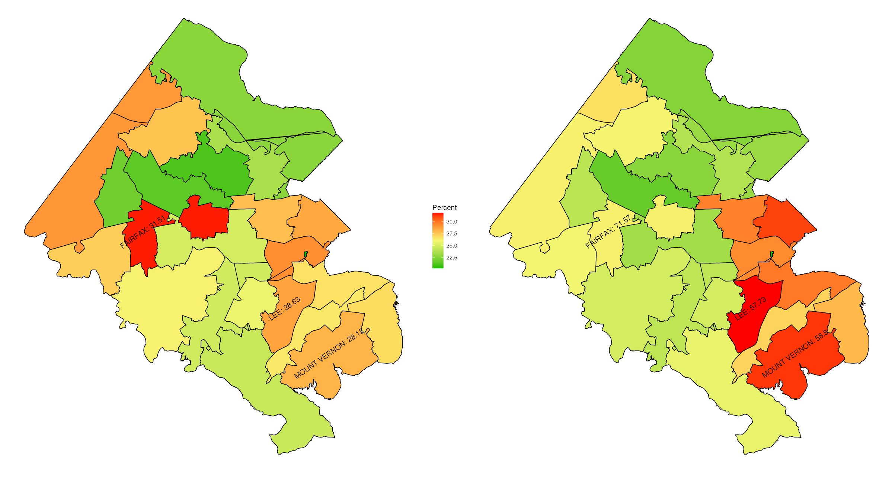
% Students Reporting Depressive Symptoms (left)
and % Students Reporting Extracurricular Regularly (right)
Shades of green = relatively good (light) to good dark)
Red = bad; e.g. high % of students with depressive symptoms
Shades of gold = in the middle from light gold (top middle) to dark gold (bottom middle)
Each area on the map is a high school pyramid boundary that includes the high school, middle schools, and elementary schools for that boundary.

Slide 87
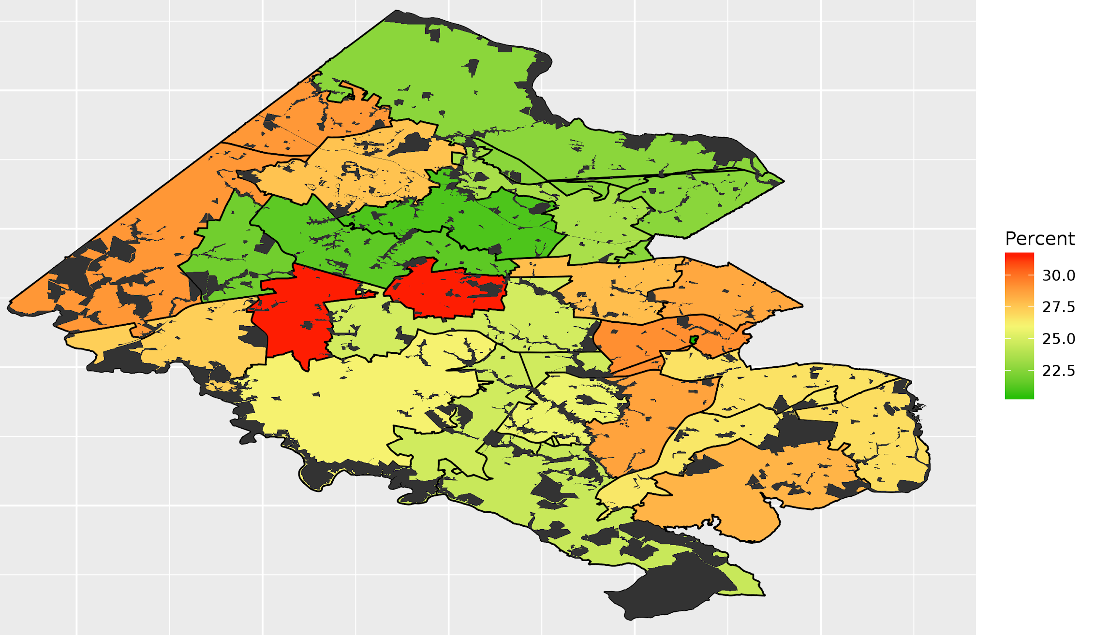
% Students Reporting Depressive Symptoms and Availability of Parks in Fairfax County (black shaded areas)
Shades of green = relatively good (light) to good dark)
Red = bad; e.g. high % of students with depressive symptoms
Shades of gold = in the middle from light gold (top middle) to dark gold (bottom middle)
Notes:
No clear relationship - make this point

Slide 88
Psychology Today Web Scrape
SAMHSA lists mental health service providers that are funded by a state agency -- incomplete
psychologytoday.com has a directory of mental health service providers
Scraped addresses of every therapist, psychologist, and psychiatrist in Fairfax County listed on their website
Converted address strings to lat-longs in Google API
Overlaid locations on a heat map of students reporting depressive symptoms by school boundary
Notes:
NOTE: List sources

Slide 89
Steps Ahead
Creating a synthetic data set of all residents in Fairfax county using PUMS_PERSONAL and ACS to capture ACS variables of interest by high school pyramid boundary
Reason for imputation: ACS variables are by ZCTAs and not School Boundaries
Run a simple logistic model with the Fairfax Youth Survey microdata
ZCTA are Zip Code Tabulation Areas used by Census Bureau
Notes:
ZCTAS : Zip code tablulated area. More exploratory analysis on characteristics in school boundaries. Later do a chi-square test to test for significance

Slide 90
Community Projects:
Roanoke - Refugees
Team: Claire Kelling, Adrienne Rogers, Hannah Brinkley
Kyle Morgan, Craig Mortan
SDAL: Gizem Korkmaz, M. Orr
Sponsor: Virginia Tech Global Forum for Urban and Regional Resiliency

Slide 91
Project Description
Part of the Community Indicators Project
SPIA, Global Forum and other groups are interested in expanding capacity at Virginia Tech for understanding refugees
Research Questions:
1) How can we measure the integration of refugees into host communities and countries?
2) How can we measure the economic impact of refugees on host communities and countries?
Literature Review:
Cleveland Case Study
UN provided guidance on research questions to the Virginia Tech teams

Slide 92
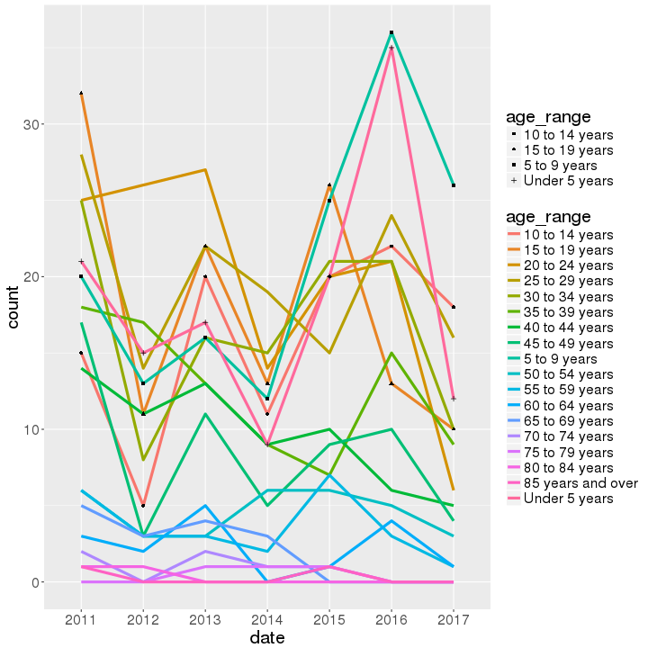
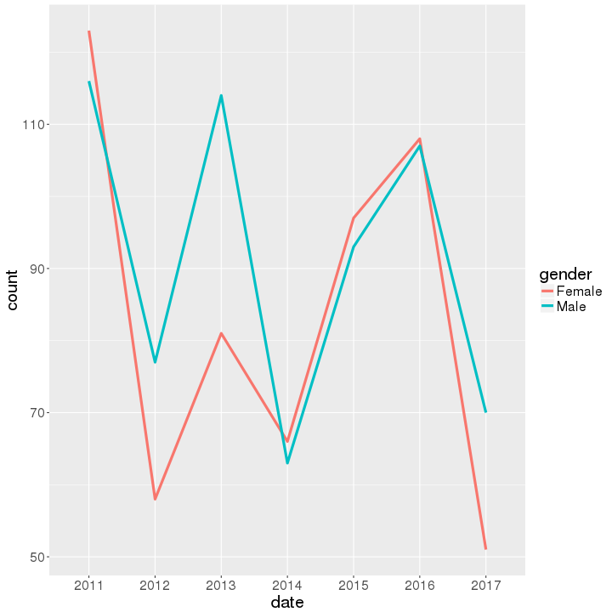
Local Data Analysis
Virginia Department of Health:
Most refugees in Roanoke are young (0-19)
Gender distribution is fairly even over time

Slide 93
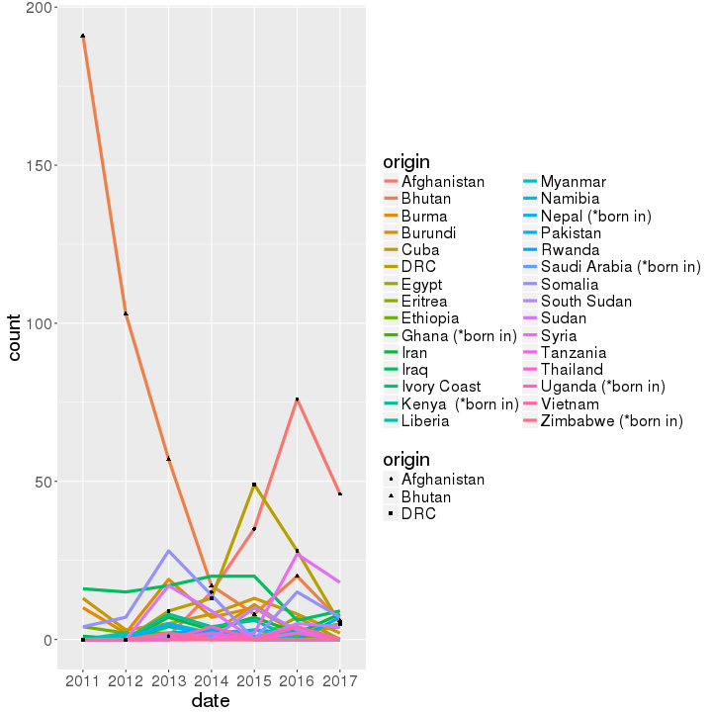
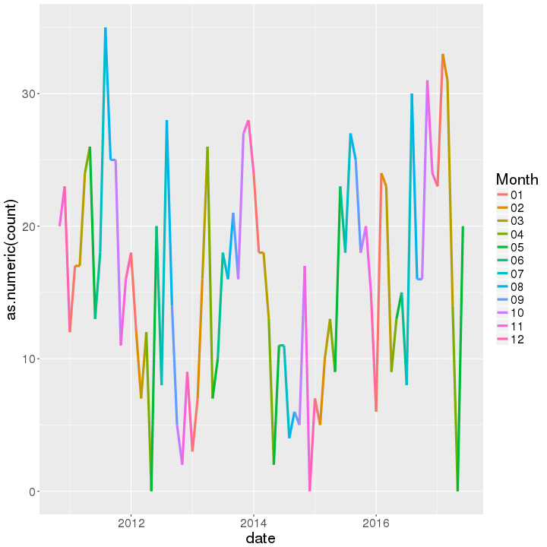
Local Data Analysis
Virginia Department of Health:
Not much of a seasonal trend (such as spikes in the beginning of the year)
Most refugees in Roanoke are from Afghanistan, Democratic Republic of the Congo, and Bhutan (with recent increases from Syria)

Slide 94
Local Data Analysis
Virginia Newcomer Information System:
Clients: Asylee, Refugees, SIV virus, Other (Trafficking Victims and Cuban Haitian Entrants)
Clients entering employment within 90 days of intake:
Roanoke: 51%
State Average: 48%
Percent of employed Clients working Full Time:
Roanoke: 73%
State Average: 68%

Slide 95
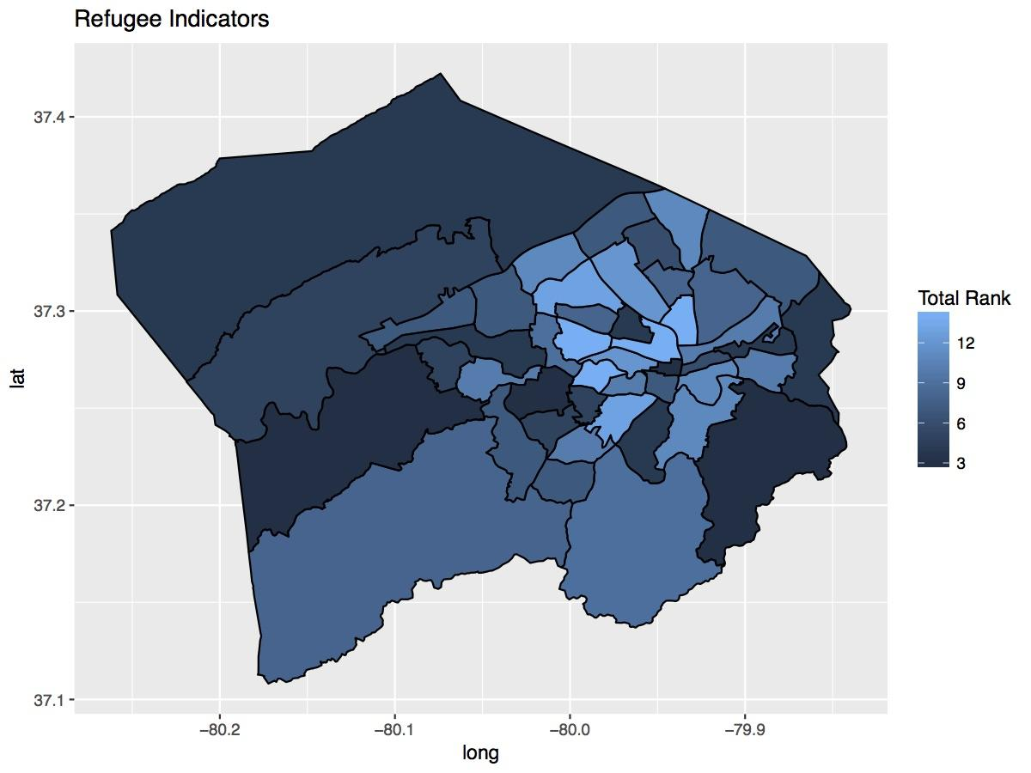
Refugee Indicators Index
Used American Community Survey (ACS) data tables from Roanoke County, Roanoke City, and Salem City at the Census Tract level
Variables used from the ACS:
Number of foreign-born people who are not citizens
Number of people from countries that the U.S. takes refugees from
Number of people who either speak English poorly or do not speak English at all

Slide 96
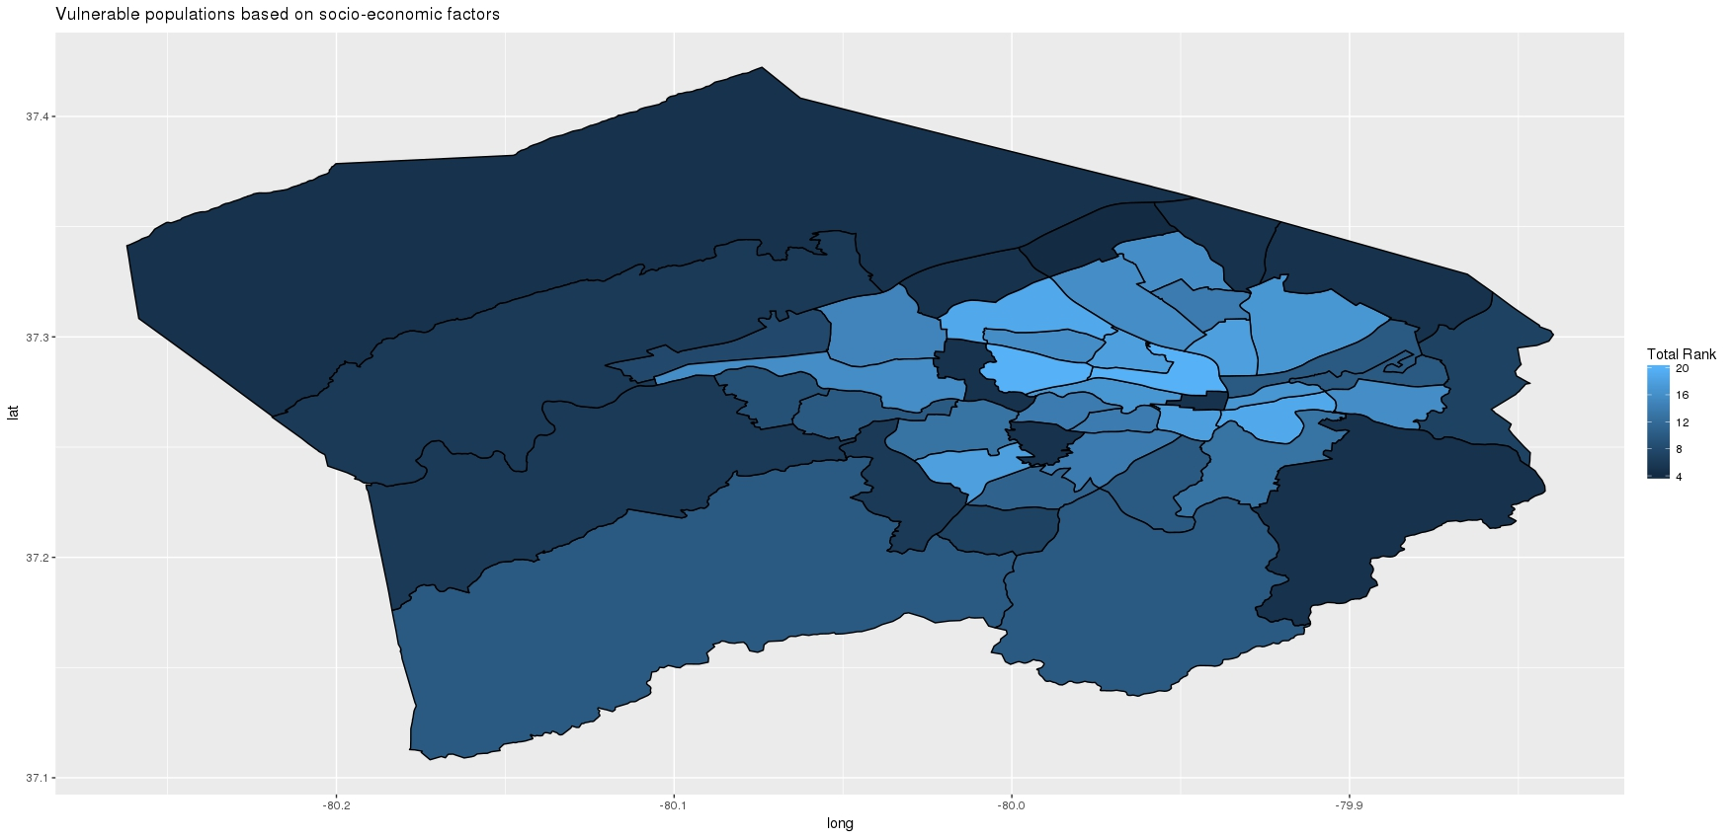
Economic Indicators Index
Similar to the Refugee Indicator’s approach, we put together a map of some variables that have to do with economic vulnerability
Variables we looked at were all on the household level:
households that received food stamps
households that have no vehicle
households that have income below the poverty line
households that spend more than 50% of their income on rent / mortgage
Variables were found for the census block level to keep it homogenous
Similar to the map before, a lot of the variables have high composite scores closer to the city of Roanoke
Vulnerable populations based on Socio-Economic Factors

Slide 97
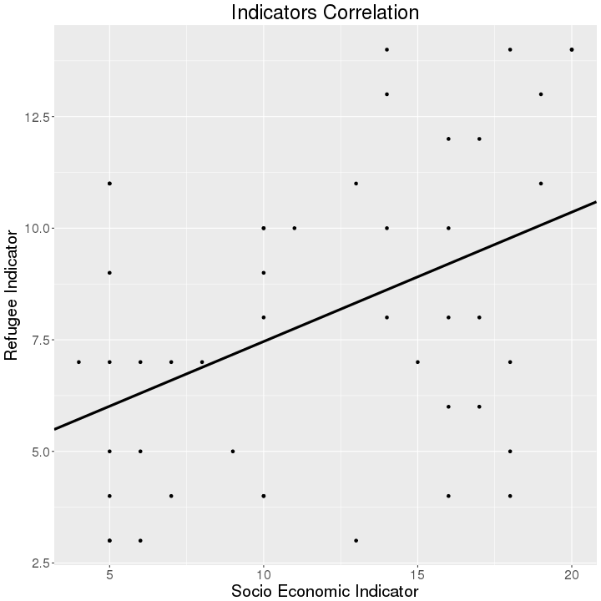
Refugees and Socio Economic Indicators
Refugee Indicator & Socio-Economic Indicator
These two indices do not seem to be well correlated (46 census tracts)
Correlation: 0.4382
Regression r²: 0.192
Considering additional/removing variables

Slide 98
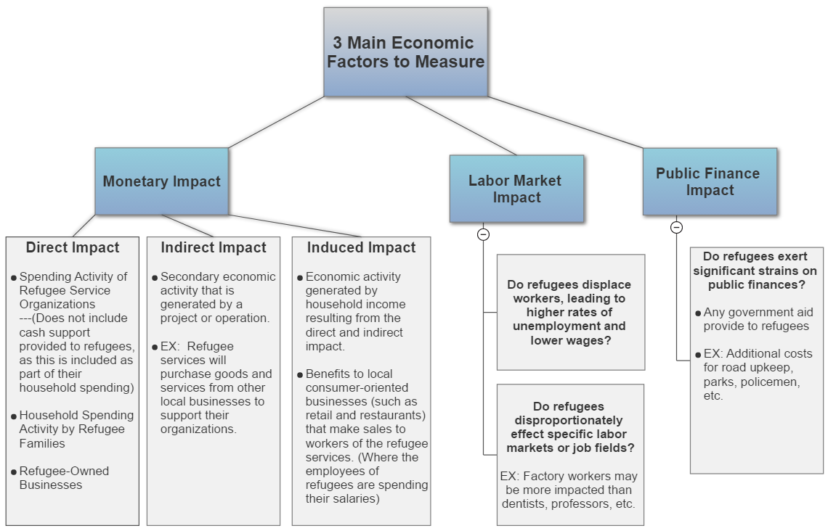
Economic Indicators
Cleveland Case Study:
Used a survey of refugee organizations and refugees to obtain data on refugee spending, housing, and employment

Slide 99
Challenges
Challenges of measuring economic impact:
Lack of access to refugees / local data
Staggered arrival dates
Getting input from local businesses
Infeasibility of determining whether refugees are “replacing” other workers or simply filling open jobs
Cleveland Case Study:
Not a viable option due to our lack of access to refugees that would have been necessary for a survey

Slide 100
Analyzing Economic Characteristics
Assess Economic Characteristics of communities likely to have larger Refugee populations compared to Roanoke County averages
Create Index of Economic Status compared to Roanoke County Averages
Based on research by Appalachian Regional Commission
Variables to look into for assessment:
ACS: Food Stamps/SNAP, Public Assistance, Employment, Renter Housing Costs
Others: Tax Brackets, Charitable Income
Issues:
This analysis will only measure economic characteristics of refugee-inhabited areas, not the impact on refugees themselves
Future Questions:
How do these areas compare to known areas with more and less refugees?

Slide 101
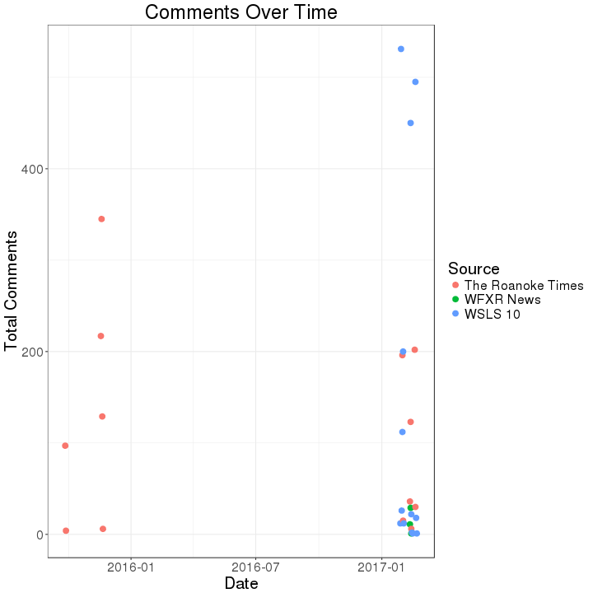
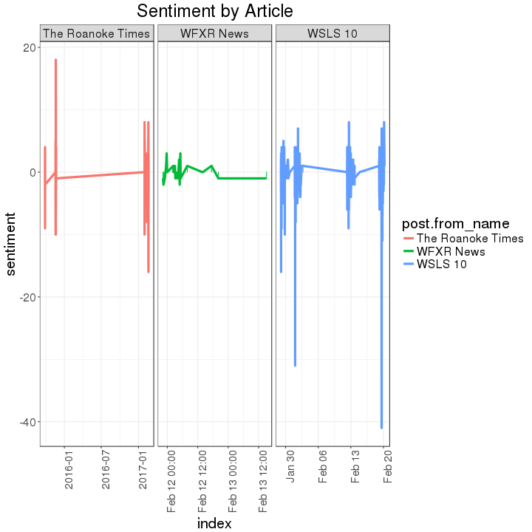
Sentiment Analysis
Data Source: Local Roanoke News Facebook pages
The Roanoke Times, WSLS 10, WFXR News
Scraped 3,329 comments from 12 articles
Focused around two events:
Roanoke Mayor David Bowers requested suspended assistance to Syrian refugees
Recent political events surrounding presidential policies

Slide 102
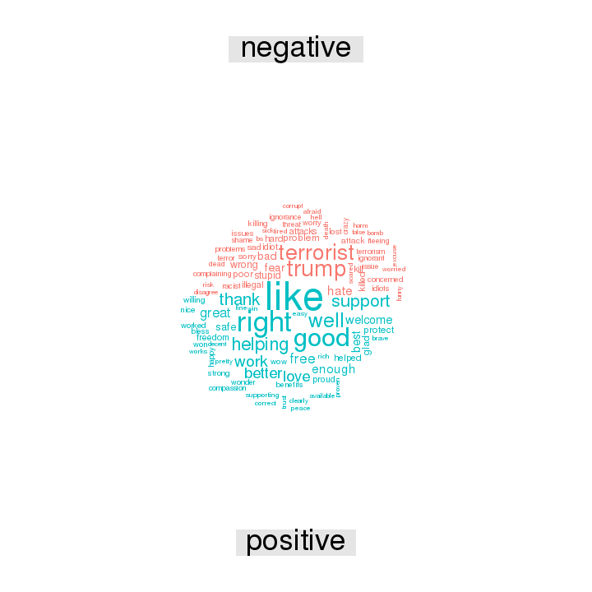

Sentiment Analysis
Sample: "Mayor Bowers was thinking of the welfare and security of all Roanoker's. Also, it appears that while taking the position he is also concerned with what would happen if the group of refugees were possibly infiltrated by a terrorist that, like the Paris attacks, would only be hours away from the Nation's Capitol and seemingly in a nice quiet place where havoc and widespread destruction could be planned. Like the Paris attacks. I, for one, stand and give Mayor Bowers my full support. The current Administration has no idea who these people are and the possibility exists that just one of however many refugees that would settle in Roanoke could be a terrorist. And that is one too many. Mayor Bowers is thinking clearly and should stand his ground. Regardless of what the city council or any celebrities have to say. Mayor Bowers represents the people of Roanoke."

Slide 103


Latent Dirichlet Allocation (LDA)
LDA: a generative, unsupervised statistical model that allows a set of observations to be explained by groups
We performed this analysis for the Facebook comments, from our three sources
Chose the number of categories to be 4

Slide 104
Next Steps
We have analyzed sentiment in two ways
How can humans validate our findings?
Amazon Mechanical Turks to validate our sentiments/categorization
Formulate a manuscript

Slide 105
New Kent County
DSPG - David Park, Joseph Kim, David Hinkle, Lata Kodali
SDAL - Dave Higdon, Aaron Schroeder, Stephanie Shipp
Sponsor - Virginia Cooperative Extension (VCE)

Slide 106
Project Description
VCE Representative: Carl Frick
Issues:
New Kent County is growing, and there is a perceived increase in the number of youth who have nowhere to go after school. These teenagers might be engaging in risky behaviors.
Lack of transportation for programs such as 4-H and barriers to enrollment in 4-H.
Goal 1: Find data related to drug use amongst the youth in New Kent. Discover what is causing the change in drug use.
Goal 2: Provide a way to compare New Kent County to other VA counties.

Slide 107
Project Overview
Basic profiling of New Kent County using:
ACS data
Housing data
Virginia Department of Education (VDOE) data
Social media data
Plotted the data collected to see trends in New Kent
Conducted a field study by visiting New Kent and met with Carl (Co-op Extension agent)

Slide 108

ACS New Kent Housing Data
Notes:
NOTE: Add data source
One thing we wanted to look at for New Kent to see was if there was a trend in population over time. From this graph, pulled from an acs table, it shows clearly that there was a large spike in move ins to New Kent from 2000 to 2009.
Other from this graph we have several other housing data sets that we are planning to explore and see what we can find from them.

Slide 109

ACS Household Type Profile
Notes:
NOTE - needs more explanation. What is key take away?

Slide 110


New Kent School Profiles
New Kent Elementary
George W. Watkins Elementary
Notes:
Note: Add source of data to slides, What is key take away?

Slide 111


New Kent School Profiles
New Kent Middle
New Kent High
Notes:
Note: Add source of data to slides

Slide 112

New Kent School Profiles
Total School Population
Notes:
Note: Add source of data to slides, What is key take away?

Slide 113

New Kent School Profiles
Notes:
Note: Add source of data to slides, What is key take away?

Slide 114

4-H Survey Data
Risk Factors survey answered by 49 Cooperative Extension Agents
Example Questions
What are the biggest issues facing youth in your unit?
Poverty/Lack of Money
Drugs
What are the most significant barriers to 4-H participation in your unit?
Transportation
Competition with other activities
Source: 4-H Survey provided by Carl Frick.

Slide 115

OnTheMap: Employment In and Outflow
Source: https://onthemap.ces.census.gov/

Slide 116

OnTheMap: Distance to Work
Source: https://onthemap.ces.census.gov/

Slide 117

New Kent Social Media Data

Slide 118
Future Work
Dashboard:
Compare variables across VA counties
Provide visuals including map and basic plots
Model:
Variables of Interest vs. Problems in Respective Counties (e.g. drug use, poverty, transportation).
Challenges:
Finding data sources that show trends for New Kent County.
Lack of data to analyze for New Kent, e.g. crime data

Slide 119
Questions
Thank you.
Comments?
Suggestions?

Slide 120
Community Projects:
Arlington - Needs Assessment
PI : Vicki Lancaster
Team: Madison Arnsbarger, Chanida Lerdritsomboon, Harsimrat Pandher (Simmu), Sean Pill
Sponsor: APAH (Arlington Partnership for Affordable Housing)

Slide 121

Project Overview
Our Sponsor- APAH (Arlington Partnership for Affordable Housing)
Identify service gaps and mobilize citizens to close these gaps in zip code 22204.
Preschool and Childcare
Workforce
They are funded by the Citibank Community Progress Makers Fund and must report to their donors.
Plan to host a workshop for APAH and the Community Progress Makers roster where we show them how to find the information they need to conduct a needs-based assessment of zip-code 22204 independently, since most of it is readily available.
Notes:
Wants us to conduct a needs-based assessment.of Arlington County residents belonging to zip code 22204 to identify service gaps and mobilize citizens to close these gaps in that area.
Preschool and Childcare
Workforce
They are funded by the Citibank Community Progress Makers Fund and must report to their donors.
We are planning to host workshop for APAH and the Community Progress Makers roster where we show them how to find the information they need to conduct a needs-based assessment of zip-code 22204 independently, since most of it is readily available.

Slide 122

Background: Snapshot of Zipcode 22204:
Report Area Data Taken from Community Commons | Percent Free/Reduced Price Lunch Eligible | Percent Families with Income Over $75,000 | Percent Population Age 25+ with No High School Diploma | Percent Population Under Age 18 in Poverty
22204 Estimates | 52.38% | 54.59% | 13.55% | 22.3%
Arlington County, VA | 30.91% | 73.82% | 6.52% | 11.37%
Notes:
Wants us to conduct a needs-based assessment.of Arlington County residents belonging to zip code 22204 to identify service gaps and mobilize citizens to close these gaps in that area.
Preschool and Childcare
Workforce
They are funded by the Citibank Community Progress Makers Fund and must report to their donors.
We are planning to host workshop for APAH and the Community Progress Makers roster where we show them how to find the information they need to conduct a needs-based assessment of zip-code 22204 independently, since most of it is readily available.

Slide 123
Background: The story of Zipcode 22204
Socioeconomic/Demographic Factors
Community Commons: Community Health Needs Assessment Report:
Compares 22204 data to the rest of Arlington.
Quality of Public Transit
AllTransit Score: Combines information regarding “can I get transit” with “Jobs accessible in a 30 Minute Transit ride and combines them in a way that is reflective of what fraction of people use transit for their journey to work. Ranked 0-10 and available at block-group level
Social Vulnerability
CDC: SVI Index, a 0-100 index, ranked by Census Tract, uses 15 ACS variables to measure a Tract’s relative Vulnerability to a disaster
Notes:
tell that it’s intersting only 21% of ppl are using mass transit

Slide 124


Child Care Availability in 22204
Types of Child Care Services:
Child Development Centers
Family Child care Centers
Preschools
Church-Based Child care
Data Sources:
Arlington Country Open Data
Childcarecenter.us
Carelulu.com
Daycare.com
American Community Survey 2010 - 2015
Childcare for children ages 0-5 in 22204:
Assumption: Children who are not in child care services utilize family and friends for care.
Total Number of Children | 3,418
Children in Child Care Services | 1,059 (31%)
NOT in Child Care Services | 2,359 (69%)

Slide 125
Childcare Affordability in 22204
“The US Department of Health and Human Services has established that in order to be considered affordable, families would spend no more than 10% of their gross income on child care.”
Arlington County 2018 Proposed Budget
 | Median Income of Families with Own Children in Home ($, 2015) | Annual Cost of Childcare for an infant and 4-year-old ($) | Cost of Childcare as Percentage of Income
22204 | 65,037 | 28,350 - 29,484 | 43.6 - 45.5%
Arlington | 148,629 | 40,521* | 27.3%
Virginia | 79,400 | 21,476 | 27.0%
* annual cost for an infant and 4-year-old in Washington, D.C. (DC Office of the State Superintendent of Education, May 2014)
Notes:
Family households with own children under 18 years comprise only 21.4% of Arlington households - explaining the stark contrast in median income here vs for the county overall (~ $100,000) .. AC2017 Profile
Figures from KIDS COUNT Data Center (Annie E Casey Foundation), which uses ACS tables.
In 22204 row, the ranges are (50 work weeks/year - 52 work weeks/year)
Emily:
ACS dual working parents
parnents with multiple kids under 5 (are they move likely to use family/friends because they can’t use daycare)
more infants than infant spots because of stricter regulations regards to ratio fo caretakers/infants

Slide 126
Barriers for using existing services
Physical space needs and constraints
Childcare providers prefer to be located on the first floor of a building
Must provide outdoor element for children’s play and activity
Costs
Rent is expensive
Cost of services is overall expensive
Regulatory requirements
Reduction in capacity of programs
Parking
Perceptions
Negative perception of child care uses within office buildings
Average weekly rate for 12 child care providers:
Age | Cost
Infant | $300.58
Toddlers | $300.58
Age 2-3 | $291.26
Age 3-4 | $285.30
Age 4-5 | $267.45
Source: Arlington County 2018 Proposed Budget
Notes:
Challenging to find 6,000-10,000 square feet space
Must provide outdoor element for children to run around
Play areas/ appropriate walking routes
Rent is expensive
$30- low $30s per square foot is max rent that child care providers can afford
Plan submittals cost can quickly escalate because the County requires a lot of details
Regulatory requirements
Reduction in capacity of programs
Strict regulations regarding ratios and staff education levels
Parking
Some programs may not have parking to accommodate the provider; thus, increasing cost to find parking elsewhere
No mechanism for County Board to change the required parking ratios as of now
Perceptions
Negative perception of child care uses within office buildings
Noise/visual impact and aesthetic
Side note: Another hindering factor: Not all child care providers picked up when I called, thus, making it hard to schedule an appointment
-Data Sources:
- Arlington County Open Data
-Childcarecenter.us
-Carelulu.com
-Daycare.com
-County Manager’s Message from FY 2018 Proposed budget page 41

Slide 127
Home Care Providers Hours and Summer Child Care Services Available
Home Care Providers Hours:
Ranges from 6:00am- 5:30pm
Arlington 2017 Summer Camps Catalog:
23 camp locations within zip code 22204
Ages range between: 3-13 year olds
Fees are different depending on the type of activities provided by the camp
Ranges from $120-$160 weekly
Data Sources:
Arlington Country Open Data
childcarecenter.us
carelulu.com
Daycare.com
County Manager’s Message from FY 2018 Proposed budget page 41
Notes:
Side note: Another hindering factor: Not all child care providers picked up when I called, thus, making it hard to schedule an appointment
-Data Sources:
- Arlington Country Open Data
-Childcarecenter.us
-Carelulu.com
-Daycare.com
-County Manager’s Message from FY 2018 Proposed budget page 41

Slide 128
Potential additional services:
Look to other cities (Richmond, VA)
Office of Community Wealth Building “serves as the collective impact hub for an informed, energized, and aligned community of non-profits, ministries, government agencies, funders, businesses and people - Community Wealth Builders.”
Send-A-Kid-To-Camp Campaign
Transitional Daycare Subsidy: provides childcare assistance for 12 months after TANF benefits end (for income-eligible families).
Incorporate affordable childcare facilities in first floor of APAH buildings
Convenient locations for low income families
Create a survey for residents
Notes:
Richmond has an official department that appears similar to the Community Progress Makers. This enables better cooperation and integration of public and non-profit services.
Send-A-Kid-To-Camp Campaign is an annual radiothon that raises scholarship funds to send Richmond children to Parks & Rec camps. This is a partnership between a nonprofit and radio station local to Richmond.

Slide 129
Workforce
Where do people work?
What is the self-employment rate?
What benefits and packages are available to individuals?
What type of training, if any, would they need to make a career advancement? What are the barriers to attending the training?
What are the commutes like?
Do people use public or private transit?

Slide 130

What are the commutes like?
OnTheMap (V6.5)
Web-based mapping and reporting application that shows where workers are employed and where they live. Based on the a partnership with the U.S. Census Bureau and Local Employment Dynamics (LED) partner states.
Zip Code 22204
Distance/Direction Analysis
https://onthemap.ces.census.gov/tot/

Slide 131

Where do people work?
Data Sources
Longitudinal Employer-Household Dynamics (LEHD) which has several data products that characterize workforce dynamics, such as the LEHD
Origin-Destination Employment Statistics (LODES).
Zip Code 22204
Inflow/Outflow Analysis
https://onthemap.ces.census.gov/tot/

Slide 132
Where do people work?
Living in 22204 (25,843) + Working but living outside 22204 (5077) = 30,920
Close to 32,399, just outside of the lower bound their 90% confididence interval range, 31,300.
Zip Code 22204
Inflow/Outflow Analysis
https://onthemap.ces.census.gov/tot/

Slide 133

Where do people work?
https://onthemap.ces.census.gov/ 22204 Work Area Profile Analysis
Differences between those working in and outside of 22204 ( note not all categories are the same and we are comparing 2014 to 2015)
Accommodation and food services: 16.4% of those working in 22204 compared to 9.9% for all residents
Construction: 2.6% of those working in 22204 compared to 9.8% overall.
Public Administration: 1.2% of those working in 22204 compared to 11.8% of all residents
Education: 2.1% of those working in 22204 compared to 8.4% of all residents
Arts Entertainment and recreation 5.6% of those working in 22204 compared to 1.8% of all residents.
Administration & Support, Waste management 9.8% of those working in 22204 compared to 4.51% of all residents..
Health Care and Social Assistance 14.2% of those working in 22204 compared to 8% of all residents
Wholesale Trade: 5.3% of those working in 22204 compared to 1.3% of all residents

Slide 134

Generated Report: Community Profile Report of Zip Code Tabulation Area: 22204, Employment By Industry via PolicyMap
Data Sources
Longitudinal Employer-Household Dynamics (LEHD) which has several data products that characterize workforce dynamics, such as the LEHD
Origin-Destination Employment Statistics (LODES).
Zip Code 22204
Inflow/Outflow Analysis
https://onthemap.ces.census.gov/tot/

Slide 135



What is the self-employment rate?
Release Date of 2015 Returns
Self-employment Rate =
(Total Self-Employed 22204)/(Total Employed 22204) =
4330/27500 = 0.16
https://www.irs.gov/uac/soi-tax-stats-individual-income-tax-statistics-2014-zip-code-data-soi

Slide 136

What benefits and packages are available?
Individual
Retirement Accounts
Retirement Savings Contributions Credits,
Pensions and Annuities in AGI
https://www.irs.gov/uac/soi-tax-stats-individual-income-tax-statistics-2014-zip-code-data-soi

Slide 137
Next Steps
Prepare data workshop for APAH and their partners
Share data sources
Explain readily available search and analysis tools
Walk through less-intuitive data collection techniques
Make recommendations to APAH to address service gaps in 22204

Slide 138
ARI - Army Base Profiling
Team: Zarni Htet, Adrienne Rogers, Joseph Kim, David Hinkle, David Park
SDAL: Josh Goldstein, Stephanie Shipp
Sponsor: The US Army Research Institute for Behavioral and Social Science Research

Slide 139

Project Description
Sponsors: The US Army Research Institute for Behavioral and Social Science Research
ARI representatives: Greg Ruark and Andrew Slaughter
Project Title: Towards an Integrated Data Framework for Understanding the Context of Army Environments: A Case Study of Attrition of Army Soldiers
DSPG Project Goals: Do Soldiers leave the Army because of better opportunities in civilian life?
Identify publically available data sources (e.g., Census and BLS data) to create social, demographic, economic, and other quantitative profiles of Army bases and their surrounding areas
Notes:
Our sponsor is the US Army Research Institute for Behavioral and Social Science Research. And our goal for this project has been to answer the question “Do Soliders leave the Army because of better opportunities in civilian life? In order to do this we have been investigating the opportunities, specifically given to them in around around the geographic area of the bases they are stationed at. To go deeper into this process, I will pass you on to David.

Slide 140
Process Overview
Data Exploration:
ACS data
Ex: Educational Attainment and Marital Status
BLS data
Ex: JOLTS*, OES*, CES*, and CPS*
Exploratory Analysis: Uses visual analysis to understand demographics 1. Location of the fort 2. Bar Graph of side by side comparison of the fort and the surrounding areas 3. An aggregated form of the Bar Graph 4. ACS data plotted into a geographic map
National Analysis: Creating a user friendly dashboard for visuals, comparisons, and to allow for automated approach to produce each profile
*Acronyms - JOLTS- Job Opportunity and Labor Turnover, OES- Occupational Employment Statistics, CES- Current Employment Statistics, CPS- Current Population Survey

Slide 141
Data Discovery
U.S Census Bureau, American Community Survey (ACS): Gathered all tables of interest from ACS. Pulled military and demographic variables for future use
Bureau of Labor Statistics (BLS): Gathered relevant BLS data and also wrote a brief description of each survey
Base Names / ZIP Codes: Manually compiled a list to match zip codes and their bases.
Notes:
Provide list of tables

Slide 142



Zip Code v. ZIP Code Tabulated Area
Zip Code: a five-digit number representing a USPS delivery area
Can lead to over counting
ZIP Code Tabulated Area (ZCTA): a five digit number representing a generalized area of the USPS Zip Code service area. NOT the same as Zip Codes
A ZCTA does not cross county lines
A ZCTA is based on population
https://www.policymap.com/2016/03/what-are-zip-code-tabulation-areas/
Notes:
When determining what level to actually collect our data by, our first instinct was to collect by Zip Codes seeing as the army database uses zip codes, allowing for future linkage. But, what we learned along the way is that Census data will be over counted because the census organizes zip data by ZIP Code Tabulated areas. These areas are basically a generalized form of the USPS ZIP Codes that are defined to not cross county lines and better represent the population in the area. You can see on the screen that these areas can match the zip code areas pretty well, contain the zip code are or just be completely different from the zip code area itself.

Slide 143
Exploratory Analysis
Goal: Use ACS data to understand the social and economic makeup of Fort compared to surrounding area
Targeted ACS Variables: Educational Attainment, Children Under 18, Poverty Line Status, Transportation to Work, Marital Status, Sex, Race, Ethnicity, Government Assistance, Veteran Status
Process: 1. Collect Zip Codes and convert to ZCTAs 2. Gather data from ACS: Zip Matcher function 3. Create and automate plots: Function making training 4. Run RMD file to create HTML documents
Notes:
NOTE: What happened to the economic variables? Unemployment rate

Slide 144

Ft. Belvoir Overview
Compared to Fairfax County, Va., households that live on Fort Belvoir
more people have a High School degree or higher but less people have a Bachelor’s degree or higher
more people have children under the age of 18 in their household
percentage of population above poverty line is equivalent
more workers drive alone to work
population is more predominantly male
Percentage of population that is Black/African American is twice as large
Notes:
Note: What is source of data?
Note: What is ‘more people’? Do you mean
Map shows area surrounding the base while the red dots shows the location of the base itself

Slide 145

Exploratory Analysis
Notes:
Key takeaways: more people in the fort belvoir area seem to have at least an associate’s degree compared to the rest of the zip codes in the Fairfax area where a high percentage of people in the area have at least a bachelor’s degree.
An explanation for this could be that a good percentage of people at Fort Belvoir could be also be students working to get their bachelor degree.
Also judging from this plot, most people who have joined the army have at least a high school education which explains the almost absence of people who have not completed high school

Slide 146

Exploratory Analysis

Slide 147


Exploratory Analysis
Notes:
*shape file is ZCTAs
Key takeaways:

Slide 148
National Analysis
Purpose
Compare across multiple bases and surrounding areas
Dashboard
User Friendly Platform for Analysis
Visuals
Specific Variable Comparison
Saves Time
Progress
Prepared Data
Mapped Bases
Dropdowns (size & color)
Notes:
Once we had completed the base by base profiling, we had to ask, how do these individual bases compare across the board. Since it was too overwhelming to try to look at all 100 some profiles at once, we decided to create a user friendly platform to show similar analysis for all bases across the country. We are currently mid process in this. I can pull it up now. Right now, it is using dummy data but, we are formulating a large dataset that will include all of the ACS variables we are looking at for all bases. The goal is to have points as each base (like you see here) sized by population and colored based on ACS variable. Right now you can see how the color changes as we change our dummy variables. We also, will include the plots shown before on this drop down menu. And have interactive points that gives you basic information about each base.

Slide 149
Future Work
Incorporate Data
PDE with ACS
Model
Combined Data vs. Attrition Rates
Notes:
So, that is our major goal for future work. But, we are also looking to link this data with data given to us from the Army through the PDE. And eventually, use this ACS, PDE and BLS data to create a model for attrition rates.

Slide 150
Questions

Slide 151

WMATA Bus Fare Evasion
DSPG - Craig Morton, Eirik Iversen, Harsimrat Pandher (Simmu), David Hinkle, Zarni Htet, Lata Kodali
SDAL - Vicki Lancaster, Gizem Korkmaz, Aaron Schroeder, Joshua Goldstein

Slide 152
Project Description
Sponsor: Washington Metropolitan Area Transit Authority (WMATA)
WMATA Representative: Catherine Vanderwaart
Problem: WMATA loses approximately 10-20 million dollars a year due to fare evasion on its 1300-1500 daily bus trips.
Research Goal: Define fare evasion and analyze several different data sources from WMATA to find determinants of fare evasion.

Slide 153
Project Outline
We will provide:
Literature Review
Will cover history of fare evasion in context of WMATA
Tried methods of dealing with evasion
Data Discovery
Involves working with WMATA given data and ACS data to understand fare evasion.
Data Integration & Statistical Analyses
Possibility quantify bus fare evasion
Demographic profiles of neighborhoods where evasion occurs
Notes:
The literature review will be on the topics of bus fare evasion and its history in the
context of WMATA. It will cover what has been tried and tested in other transit agencies
to tackle the problem. The literature review will guide data discovery and statistical
model development.
The data discovery process will involve working with WMATA employees to acquire
the appropriate data sources to accurately tell the story of Metrobus over its existence.
Other local, state, and federal sources will be used to augment the WMATA data to
provide geographically and time relevant insights.
The data integration and statistical analyses will address whether it is possible to
quantify the types of bus fare evasion (e.g. farebox malfunction, rider non-compliance
[rider not paying anything or only a portion of the fare], rider fails to successfully swipe
their SmarTrip Card). It will also include development of demographic profiles of the
neighborhoods where the fare evaders board the bus. These analyses will be used to
propose intervention strategies and future research.

Slide 154
Plan
Pinpoint fare evasion at the census block group level by observing morning commutes between 5-10 AM on weekdays.
Understand economic vulnerability of those census block groups which contain bus stops.
Define fare evasion and determine highest fare evading census block groups.
Determine sources of variability within those highest groups.
Combine economic vulnerability along with feasible tactics to reduce fare evasion.

Slide 155
WMATA Datasets
Bus stops
Contains bus stop ID, description, latitude, and longitude.
10,988 observations of 5 variables.
Approximate Person Counter (APC)
Contains front and back door entries and exits for a given bus, route, and bus stop.
3,779,527 observations of 20 variables.
Farebox
Contains cash and smartrip transactions for given bus, trip number, and bus stop.
2,729,668 observations of 17 variables.

Slide 156


Data Processing
Attached census block group information
Concentrated on weekdays from 5-10 AM
Calculated number of riders on the bus for APC
Cleaned APC and Farebox datasets
Created master file aggregated at the census block group (CBG) level with following variables:

Slide 157
Economic Vulnerability
In order to understand populations that might be more at risk to not be able to pay their fares, we:
Created an economic vulnerability index
Looked at four variables on the household level for block groups
Block groups that have a high number of houses receiving food stamps
High number of households that have no vehicle
High number of households that have an income below the poverty line
High number of households that spend more than 50% of their income on their rent / mortgage
Take these variables and assign them a one to five quantile based on the range of the number of households
Add up scores across the variables to get a composite rank out of 20

Slide 158

Economic Vulnerability Map
7 counties WMATA services
Colored BGS contain bus stops
High rank means high economic vulnerability
Notes:
Crop the image. Take out axes.

Slide 159


Fare Evasion
We estimate fare evasion by the following measures:
8 Key presses
A button the bus operator presses when they observe an instance of fare evasion
Count of APC back door entries
People entering the bus from the back door
Notes:
From Notice to Bus Drivers from WMATA: “If someone boards your bus and refuses to pay the fare, press the 8 key to mark the ride as fare evasion.” NOTE: We do not know how it happened, only that bus driver noted fare evasion. Also NOTE: 8 key presses is the MEASURE WMATA uses to report on fare evasion.

Slide 160

Back Door Entries
Green outline indicates a block group containing WMATA serviced bus stops.
Notes:
Crop the image. Take out axes.

Slide 161

8 Key Presses
Green outline indicates a block group containing WMATA serviced bus stops.
Notes:
Crop the image. Take out axes.

Slide 162
Top 5 in Back Door Entries
CBG | No. | Top Routes (Start-End Stations)
110010107001 (Central DC) | 113 | 16Y (Columbia Pike-McPherson), S2 (Silver Spring-Federal Tri)
110010108002 (Central DC) | 88 | 16Y (Columbia Pike-McPherson), S1 (16h St. Heights-Potomac Park)
110010074011 (Southeast DC) | 76 | A2 (Southern Ave-Anacostia), A4 (D.C Village - St.Elizabeths Gate 4)
110010044002 (Downtown DC) | 51 | 64 (Fort Totten Station- Federal Tri), 90 (Congress Heights - Duke Ellington)
110010062021 (TJ Memorial) | 51 | 64 (Fort Totten Station- Federal Tri), S2 (Silver Spring-Federal Tri)
Notes:
PLACE ZOOMED IN PICTURE HERE IF RUNNING OUT OF TIME! Otherwise Google map image of some of the routes would be great!

Slide 163


Top 5 in 8 Key Presses
CBG | No. | Top Routes (Start-End Stations)
110010074011 (Southeast DC) | 1000 | W4 (Deanwood-Anacostia), A2 (Anacostia-Southern)
110010078031 (Lower Central NE DC) | 911 | W4 (Deanwood-Anacostia), X2 (Minnesota - Lafayette)
110010075022 (Southeast DC) | 442 | W4 (Deanwood-Anacostia), 92 (U Street- Garfield Line)
110010074081 (Southeast DC) | 428 | W4(Deanwood-Anacostia), 92 (U Street- Garfield Line)
110010104001 (Southeast DC) | 428 | W4(Deanwood-Anacostia), A2 (Southern Ave-Anacostia)
Notes:
ROUTES NEED TO HAVE SOME INFORMATION
For each bus stop, there are

Slide 164
Top 5 with Economic Vulnerability Index
Back Door Entries:
8 Key Presses:
CBG | Rank
110010107001 (Central DC) | 6
110010108002 (Central DC) | 17
110010074011 (Southeast DC) | 19
110010044002 (Downtown DC) | 18
110010062021 (TJ Memorial) | 16
CBG | Rank
110010074011 (Southeast DC) | 20
110010078031 (Lower Central NE DC) | 19
110010075022 (Southeast DC) | 20
110010074081 (Southeast DC) | 15
110010104001 (Southeast DC) | 19

Slide 165
Next Steps
Routes
Trips (5-10am)
Buses
Bus Stops
APC
FareBox
Back Door Entries
8 Key Presses
Census Block Group
Routes
Trips (5-10am)
Buses
Bus Stops
APC
FareBox
Back Door Entries
8 Key Presses
Census Block Group
Notes:
Aggregated Data for Census block groups
NOTES: Tie in location with tactics from lit review to combat fare evasion and economic vulnerability and understand correlation/relationship between back door entries and 8 key presses.

Slide 166
Comments
Thank you!
Questions?
Suggestions?
Thoughts?

Slide 167


Repurposing 911 Data toward Evidence-Based Policy
PI & Co-PI: Gizem Korkmaz & Josh Goldstein
Team: Claire Kelling (Penn State), Sayali Phadke (Penn State), Madison Arnsbarger(VT)
Kyle Morgan (VT), Sean Pili (VT), Craig Morton(VT), Hannah Brinkley (VT)
Sponsor: Arlington County Police and Fire Departments

Slide 168
Project Overview
Overall goal is to improve “Situational Awareness”: to improve quality of life and services while accelerating the county’s efficiency and resiliency
Research Questions
Featured Events: What to expect from specific events so that the Police Department can be better prepared?
Characterizing Communities: What are characteristics of communities that encounter specific types of crimes?
Response Time: Which factors affect emergency response time?

Slide 169
Impact of Featured Events on
Crime Patterns
PI & Co-PI: Gizem Korkmaz & Josh Goldstein
Team: Sayali Phadke (Penn State), Craig Morton (VT), Hannah Brinkley (VT)
Sponsor: Arlington County Police Department

Slide 170
Main idea
Specific events may affect crime
Effect will depend on:
Type of event
Number of people involved/affected
Location of the event
Type of crime
Other time series confounders?
Police department stipulates that such an effect exists. We are testing the hypothesis
Notes:
Hannah
This project’s focus is to research how certain events could affect either types of crimes being committed or amount of crime

Slide 171
Types of events
Political events
Holidays
Weather-related events
Sports
Social events
Full-moon
Notes:
Hannah
Political events such as elections, inaurations, etc.
Holidays such as New Year’s, Halloween, etc.
Weather-related events such as the 2010 blizzard, Snowmaggen
Sports events such as the Superbowl
Social events such as food and wine festivals
Full-moon just to see if there was any patterns

Slide 172
Event-date collection
Political events
All elections during 2005-2015 for Arlington, VA manually recorded*
Sports
Events that would have a high number of people attending / draw to bars:
Marine Corps Marathon
2013 Super Bowl
Playoff games for the Washington sports teams
Social events
Arlington events since 2007 retrieved from Yelp.com
Able to get counts of number of people interested
Looking into the events with highest number of people interested
Weather-related events
2010 Snowmageddon, hottest days of the year, hurricanes/tropical storms
Holidays, and Full-moon
Manually retrieved dates for Thanksgiving, Halloween, Christmas etc. and full-moons
*https://arlingtonva.s3.dualstack.us-east-1.amazonaws.com/wp-content/uploads/sites/3/2013/09/Candidate_History.pdf
Notes:
Hannah

Slide 173
Data preparation
Police have provided two separate datasets
Incident table (inmast):
Information on crime incidents
Location
Type of incident
This is a four digit code; too many values
First two digits indicative of overall category of crime
Doesn’t contain information on time at which call was received
Call for Service table (cfs):
Exact date and time of 911 call
Merged inmast and cfs to get both the exact date and time of the call, and the location and type of incident
Notes:
Hannah

Slide 174
2009 Inauguration
The 2009 Presidential Inauguration was President Obama’s first inauguration
Washington D.C. on January 20th, 2009 around 11am
Interest
Possible increase in traffic-related crimes
Possible increase in protest-related crimes

Slide 175


Slide 176
Super Bowl 2013
This Super Bowl in 2013 was the Baltimore Ravens vs the San Francisco 49ers
Took place in New Orleans
Started at 6:30 PM EST
A local team played, so it seemed interesting
Increase in drinking-related offenses:
Disturbing the peace
Drunkenness
DWI
Notes:
http://lightfoot.vbi.vt.edu:8788/files/git/ac911_public_safety/output/Police/Featured_events/snowmageddon_2010/snowmageddon_2010.gif

Slide 177


Slide 178
Snowmageddon 2010
Snowstorm across North America resulting in ~18.7” of snow
Occurred between February 5th and 6th in 2010
Interest
Possible increase in domestic violence/ domestic abuse crimes

Slide 179

Notes:
cool!

Slide 180

Modeling
Description of the spatio-temporal markov model (need to make sure we get the terminology correct. Talk to Josh)
Maybe 1 plot?

Slide 181


Model fit (Superbowl)
No significant effect on crime rate February 3rd, 6pm-12pm...

Slide 182
Challenges and next steps
Challenges
Lost data folder!
Lack of clearer hypothesis
Next steps:
Whatever visualizations/modeling we don’t achieve by Wednesday
Show the results to police department, see if it makes sense to them, extend analysis depending on feedback
Drill down on crime types depending on initial findings

Slide 183
Characterizing Communities for
Crime Rate Inference
PI & Co-PI: Gizem Korkmaz & Josh Goldstein
Team: Claire Kelling (Penn State), Kyle Morgan (VT), Sean Pili (VT), Craig Morton(VT) Sponsor: Arlington County Police Department

Slide 184
Research Questions
We aim to “Characterize Communities” that are vulnerable to certain crime types
Modeling specific crime types
Mental Health
Drug-Related
Domestic Violence
Research Questions:
Which communities are specifically vulnerable to each of these crime types?
Do Points of Interest play a role in crime rates?
Does spatial proximity and/or travel between groups affect crime rates?

Slide 185
Literature
Most recent work is spatially focused (hotspots)
Some work in time and population-centric paradigms (community and individual profiling)
Wang et al (2016). Crime Rate Inference with Big Data: Association for Computing Machinery.
Data Sources:
(Nodal) Demographic Data: 2000 Census
(Nodal) Point-of-Interest (POI) Data: Foursquare
(Edge) Geographic Influence: boundary shapefiles
(Edge) Hyperlink by Taxi Flow: Illinois Freedom of Information Act
Our contributions:
Spatial modeling, specific crime types, new data sources/types

Slide 186
Data Sources (Descriptions)
Crime Data
Provided by ACPD
ACS
2015 ACS 5-year sample
Characteristics such as income, poverty rate, education, etc.
Facebook: 1 page per neighborhood (on avg)
Points of Interest
Public and private mental health facilities
Social: restaurants, bars, etc
Other facilities: metro stops, community centers, churches, schools, etc.

Slide 187
ACPD Data - Data Exploration
Created 3 subsets of the data based on incident and Original_Call Types
Mental Health: (6190)
Domestic Violence ((5619)
Drugs (7945)
Original call codes (DRUG) - Call codes (XXXX)
Kept observations if they had correct incident OR Original_Call Types
Wanted to find a way to asses the quality of this data before modeling it.
Studied the mismatch between original call and call incident
Notes:
Say how many unique codes there are…. Maybe don’t give the exact percentages

Slide 188
Data Exploration
First, found the number of Original_Call was correct but the incident wasn’t.
Next slide: Number of times the incident type was correct but Original_Call wasn’t.
Subset | Orignal_Calls | Frequency | Percent Mismatched | Popular_Incident_Types
Domestic Violence | DOME | 5282 | .36 | Assault (576), Drunk/Liquor, (230) Miscellaneous Officer(182)
Mental Health | MO, MOP | 2100 | .15 | Miscellaneous Officer (75), Assault(66), Drunk/Liquor (56)
Drugs | DRUG, PID | 3337 | .07 | Lost/Found Persons (73), Miscellaneous Officer(50), Citizen/Miscellaneous Public (16)

Slide 189
ACPD Data Exploration
Subset | Incidents | Frequency | Percent Mismatched | Popular Original Call_types
Domestic Violence | ASSAULT FAMILY , DOMESTICFAMILY DISTURBANCE etc. | 3715 | .09 | Assault With Injuries (32) 911 Suspicious Circumstances (30) ,Assault, Just Occurred (20)
Mental Health | MENTAL CASES, ATTSUICDSUICIDE ATTEMPTS DRUGS | 5867 | .51 | Administrative Services (1528) Overdose (426) Check on Welfare (210)
Drugs | NARCOTICMARAJUANA-POSSESING, NARCOTICNARCOTICS COCAINE - SELLING | 7714 | .60 | Traffic Stop (2456), Subject Stop (369), Suspicious Persons (209)
Notes:
Threatened Suicide Attempt (481)

Slide 190

Data Exploration - Social Media
Facebook pages of 53 neighborhoods in AC - community exploration.
Assessed the usefulness of each page
Currently have information on the number of likes per page and frequency of posts. In future will collect avg number of comments/likes per post etc. and will scrape the useful pages to use for modeling.

Slide 191
Data Exploration - Social Media

Slide 192

Characterization of Arlington- ACS
Plotting ACS variables by block group to better understand the demographics of Arlington

Slide 193

Characterization of Arlington- Crime
Plotting crime totals and crimes per capita to understand which areas are most susceptible to certain types of crime

Slide 194
Points of Interest/ Radar Search
Public Arlington Data: (Open GIS Data Portal)
Hospitals/Metro/Schools
Mental Health Providers (government and private)
Government: Substance Abuse and Mental Health Administration (SAMHSA)
Private: PsychologyToday.com
Google Maps API Radar Search:
Bars
Churches

Slide 195

Points of Interest/ Radar Search

Slide 196


Points of Interest/ Radar Search
Similar analysis will be done on the block and tract level

Slide 197

Transportation Data
The goal is to identify flows between communities as they influence each other due to interactions (in addition to geographical influence)
We use WMATA bus routes to compute the active routes (passenger volume) in Arlington County and travel volume between census block groups

Slide 198
The Model
Spatial Modeling based off of literature review paper
Unit of analysis: census block groups
Modeling ideas:
Markov Random Fields
Poisson CAR Model
Network approach to geographic data
Spatial Generalized Linear Mixed Model (SGLMM)
Spatial Point Process

Slide 199
Emergency Response Time
PI & Co-PI: Gizem Korkmaz & Josh Goldstein
Team: Claire Kelling (Penn State), Madison Arnsbarger(VT)
Sponsor: Arlington County Fire Department

Slide 200
Research Question
Goals:
To understand the impacts of various factors on fire department response time.
To ultimately improve allocation of emergency response resources and safety of Arlington residents.
Definitions:
Processing time = Alarm time → Dispatch time
Turnout time = Dispatch time → Enroute time
Travel time = Enroute time → Arrival time

Slide 201
Data:
399,158 rows, 68 columns
Years 2010 - 2015
Subset data:
exclude non-AC stations
SF cad call type
exclude turnout times longer than 10 minutes
Message Incident:
381,832 r ows
Incident:
164,900 rows
Apparatus:
344,409 rows
incidentkey | 100
station | 95.4
locationtype | 100
incidentkey | 100
userkey | 100
incidentnumber | 100
exposure | 100
incidenttype | 91.1
mutualaid | 91.1
alarmdatetime | 100
shift | 100
district | 97
incidentapparatuskey | 100
incidentkey | 100
sequence | 100
apparatusid | 99.99
apparatustype | 99.99
dispatchdatetime | 100
enroutescenedatetime | 92.82
arrivaldatetime | 80.59
cleardatetime | 99.98
apparatususe | 88.95
directions | 5.9
address1 | 53.1
latitude | 90.4
longitude | 90.4
alarms | 100
cadcallnumber | 100
cadcalltype | 100
completeddatetime | 84.2
Notes:
0.12% of the turnout times are above 10 minutes, so we make the assumption that those are special circumstances which should be excluded from the model
FD resources info

Slide 202


Exploratory Analysis:
SF CAD Calls by Incident Type
111 = building fire, 113 = kitchen fire, 118 = trash or rubbish fire
Notes:
(1xx incident types only) 111 = building fire, 113 = kitchen fire, 118 = trash or rubbish fire

Slide 203

Exploratory Analysis: Response Time Intervals
Processing Times
Turnout Times
Travel Times
Processing Time (sec)
Turnout Times (sec)
Travel Times (sec)
Notes:
each bin is 1 minute
99% of all calculated processing times are represented in this histogram (which only covers 1 hour)
91% of all calculated turnout times are represented in this histogram (which only covers 1 hour)
68% of all calculated turnout times are represented in this histogram (which only covers 1 hour)
* include NFIRS standards for response times

Slide 204

Turnout Time Model
Predictors:
Year (spline fit)
Month (spline fit)
Hour (spline fit)
Apparatus type
Station
CAD Call type*
Number of floors in station*
Model:
* these predictors will be added to the model at a later time.
Notes:
a spline is a fitted piecewise polynomial function of a given degree (usually 3) connected by a given number of knots.
knots = df - (degree)
knots = df - 3

Slide 205

Effects of Time Predictors:
Hour effect plot (with spline)
Year effect plot
Month effect plot
Hour
Year
Month

Slide 206


Effects of Station and Apparatus Type:
Apparatus Type effect plot
Station effect plot
Apparatus Type
Station

Slide 207
Future work:
Incorporate other variables into Turnout Time model.
CAD Call Type
Number of stories per station
Weather
Model other aspects of response time.
Processing time
Travel time
Investigate CAD Call types other than SF (structure fire).

Slide 208
Arlington Department of Human Services (DHS)
PI & Co-PI: Aaron Schroedner
Team: Zarni Htet, Sayali Phadke
Sponsor: Arlington Department of Human Services

Slide 209
String matching
Distance functions
Compute how two strings are similar or different based on prespecified algorithm involving operations on each character
e.g. we have a = “s phadke” and b = “sayali p”
Types of distance functions
Jaro-Winkler (JW)
Calculates how far a character is from one string to a character in another
Gives more weight to the prefix of a letter
Good for names
Levenshtein Distance (LV)
Minimum number of operations needed to transform string ‘a’ into string ‘b’
Soundex
Hamming Distance
Distance | dist(a,b)
JW | 0.5
LV | 7

Slide 210
Albuquerque Police Department (APD)
APD maintains arrest records/crime description
Manually entered by the officer-on-duty => lack of consistency in records
Department of Public Safety (DPS) maintains a crime description and category
Nine unique categories of crimes
Crime Categorization Table (CCT) contains crime description, whether it is a felony or misdemeanor, and the degree of crime
Neither of the three crime descriptions have a sufficient overlap!
Overall goal: merge the three datasets
Purpose: to allow a new arrest record to be easily matched to an existing crime description, and its corresponding category, whether it is a felony or misdemeanor, and the degree of crime

Slide 211
APD: Method
Compare each word from string1 (word length A) to each word in string2 (word length D)
Threshold Jaro Winkler score (at 0.95), and create binary word-to-word matching matrix
Find the maximum (0 or 1) for each word from string1, and sum over those to calculate N
Apply a penalty (P) of 0.01 to the each of the unmatched words to calculate N-P
For a given string1, pick the match from string2 with highest value of (N-P); giving a score S
Also document a standardized version of this score calculated as S/A

Slide 212

APD: Histogram of Matched Scores

Slide 213
DHS Arlington Motivation
Name (Sys1) | SSN | DOB | Gender
Sayali Phadke | 123-45-6789 | 10/19/1990 | F
Zarni Htet | 456-78-8901 | 05/25/1991 | F
Aaron Schroedner | 789-01-2345 | 03/07/1975 | M
Zarni | 456-78-8901 | 05/25/1991 | M
Name (Sys2) | SSN | DOB | Gender | Zipcode
Sayli S Phadke | NA | 10/19/1990 | M | 22203
Htet Zarni | NA | 05/27/1991 | M | 22202
A Schrodner | 789013445 | --/07/1975 | F | 22203

Slide 214
Problem statement
Various DHS services collect information about clients
Data stored across nine systems
Single system problem
Clerical errors (Names & Other variables being misspelt) resulting in duplicates
Multiple system problem
Each service requires different information, leading to missing data in other fields
The two problems compounded
On a given day, how many citizens did the DHS serve?

Slide 215
Three systems
What they are?
Web Vision : Behavioral Health for Children and Aging Population
ETO : Economic Independence Data
Anasazi : Community Service
What is the problem with each of them
Different data requirements
Web Vision: No SSN requirement, Babies need not have names
ETO
Running exact deduplication on some variables
Lots of legacy code with not much documentation
Our understanding: AND operations on columns like first name and last name with exact matching!!!
Data entry error

Slide 216
Probabilistic linkage
What does it mean?
A method to determine whether two items are the same, even if they do not match exactly due to different specification, or spelling error etc.
M probability (quality/reliability)
P(two field values agree | It’s a match)
Determines how good a record has been documented (SSN, for instance)
U probability (commonness)
P(two field values agree | It’s not a match)
Imagine a column of City. To distinguish between 2 people who live in D.C, not very helpful.
Composite Weight Scores
Agreement Weights and Disagreement Weights for each fields depending on agreement or disagreement
Sum those weights across each row of comparison to get Composite Score
Positive Composite: A match, Negative Composite: A mis-match
Ref : http://www.heinz.cmu.edu/~roehrig/Record%20Linkage/Fellegi-Sunter.pdf
Notes:
Fellegi and Sunter

Slide 217

Approach
Deduplicate
Deduplicate
Deduplicate
Web Vision
ETO
Anasazi
Union
Union
Deduplicate
Intermediate Table
Master Demographiic Table(User Access Portal)
New ID | Old ID | Table Code
1 | 66 | WebVision
1 | 77 | ETO
1 | 88 | Anasazi
New ID | Name | DOB | SSN | …...
1 | Zarni | 1300 | 333
2 | Sayali | 1400 | 444
3 | Aaron | 1500 | 555
Notes:
Two systems: de_duplicate/de_linkage
RBind(all)... we want all the columns in
SCHEMA
De-duplicate each system
Merge them
De-duplicate again
Retain reference ID corresponding to each system/table
Then get a NewID, OldID, TableID table
Then get the master table with one record for each person, with NewID

Slide 218

Method (contd.)
Preprocessing: DOB split, SSN etc
Two functions for deduplication by manually specifying M weights
RecordLinkage package
compare.dedup, compare.delink ⇒ Generate match pairs (expand.grid)
Single data set, Pair of data set
Parameters
strcomp: Jaro Winkler (default)
block field: eg. (first name, last name)
pairs$pairs (From Webvision)
Notes:
pairs is doing expand.grid but blocking reduces the number of pairs
otherwise it’s going to be n(n-1)/2

Slide 219
Method (contd.)
Jaro Winkler threshold for pairs$pairs
Columnwise - 0, Rowwise: Avg JW score - 0.25
Weights applied
m probability weights from Aaron’s experience
Supply into Fellegi & Sunter function ⇒ get composite scores
Clerical Review (basically eyeball for clusters)
Weight Score | Volume | Weight Score | Volume
78.57 | 2363 | 56.53 | 2819
61.78 | 5099 | 51.79 | 54

Slide 220

Method (contd.)

Slide 221

Method (contd.)

Slide 222


Automatic Weights
Automatically figuring out weights
Epi weights Current problem
a weight calculation for each pair built from Epilink calculation
run pareto threshold: Will give us an interactive way to grab thresholds!
Ref: http://www.sciencedirect.com/science/article/pii/S1532046411000372?via%3Dihub#s0030
Notes:
Absolutely no idea right now

Slide 223
Automatic Weights(contd.)
EM algorithm
Used to estimate the values required for weight calculation
E-step estimates whether the pair of records is actually the same
M-step updates conditional probabilities for computing weights of fields
Further reading underway!

Slide 224
Next steps
Investigate whether epiWeights or EMWeights are understandable and computationally feasibly option
Apply the method to ETO, Anasazi, and WebVision to check performance
Fine-tune parameters to create best possible matches
Package final method code in a way that the DHS team can implement it on all systems

Slide 225
SCHEV
Midterm Presentation
DSPG: Sean Pilli, Kyle Morgan, Ronnie Fesco, Lata Kodali
PI: Aaron Schroeder

Slide 226
Project Description
Sponsor: State Council of Higher Education for Virginia
SCHEV Representative: Tod Massa, Director, Policy Analytics & VLDS Lead
Problem: Virginia Longitudinal Data System (VLDS) contains sensitive information that cannot be released.
Researchers are interested in exploring these data, but they need to know what data to request.
These data contain many variables, and machine learning methods can be used to determine important ones.
Solution: Create synthetic VLDS data that is privatized and usable for public.

Slide 227
Project Goals
Research Goal: Create a synthetic dataset that is both usable for machine learning purposes and sufficiently privatized
Usability: Are relationships preserved between original and synthetic data?
Compare using regression models and machine learning.
Privacy: How vulnerable are certain individuals to re-identification?
Use techniques such as smoothing or top and bottom coding.
Note exact replicates and determine vulnerable demographics/ unique demographics combinations.

Slide 228
Synthpop Overview
Synthpop package in R utilizes several techniques to create synthetic data and disclosure.
Features of the package include:
Creation of synthetic data using syn().
Compare original to synthetic using compare().
Compare regression models using compare.fit.synds().
Evaluate or ensure privacy using sdc().
Notes:
If you remove replicates, you have privatized data (that is smaller)
If you don’t, then, you risk re-identification.

Slide 229

Methods for Synthetic Generation
Synthpop includes many methods:
Sample
CART
Classification and Regression Trees
Parametric
Norm
Logreg
Ctree
Conditional Inference Tree
Reduces selection bias
After exhaustive comparisons, decided on Ctree method.
Ctree Diagram:
Notes:
First partition the observations by univariate splits (CART) in a recursive way and second fit a constant model in each cell of the resulting partition.
CART: The partitions are found by recursive binary splits of the predictors. The series of splits can be
effectively represented by a tree structure, with leaves corresponding to the subsets of units.
This approach has two fundamental problems: overfitting and a selection bias towards covariates with many possible splits.
Conditional inference tree stakes into account the distributional properties of the measures.
The conditional distribution of statistics measuring the association between responses and covariates is the basis for an unbiased selection among covariates measured at different scales.

Slide 230

VLDS Sample Dataset
Dataset with 1000 observations.
ADP: ranges from 0-181 with 137 NA’s
Birth Year | 1980s | 1990s | 2000s
Count | 25 | 507 | 468
Gender | Male | Female
Count | 517 | 483
Race Type | 0 | 1 | 2 | 3 | 4 | 5 | 6 | 99
Count | 1 | 2 | 8 | 719 | 23 | 228 | 2 | 17

Slide 231

Usability
Preserving relationships are between original and synthetic data
Regression models: statistical properties such as model estimates and inferences
Machine learning: unique demographic combinations preservations
Original (left) vs. Synthetic via Ctree (right)

Slide 232

Comparison of Original vs. Synthetic

Slide 233


Regression Models
Regressing on aggregrate_days_present: Regressing on gender:

Slide 234


Machine Learning
Partitioning Around Medoids (PAM) Clustering with Gower Distances (incorporates categorical variables) .
Essentially K-Means but the centers are physical data-points.

Slide 235

Machine Learning
How do I interpret axes in higher than 2D?
Planning on Graphing 2 numeric variables at a time via a scatterplot and allowing their colors to be defined by their cluster identity.
Determining Usability:
PAM algorithm in R allows us to save the clusters as data frames so we intend to find clusters that have similar frequencies of unique demographic combinations in the dataset.

Slide 236

Data Privacy
Method:
Run syn() to create synthetic data
Use sdc() to detect and remove any rows of data that are exact replicates
Repeat 100 times
Out of 1,000 rows of data, an exact copy of a row showed up an average of 94 times in the 1,000-row synthetic data

Slide 237

Data Privacy
Method:
Run syn() to create synthetic data
Use sdc() to detect and remove any rows of data that are exact replicates
Repeat 100 times
There were a total of 649 unique rows of data that showed up unchanged in the synthetic data at least once.
Of these, the maximum was 46 of 100 runs.

Slide 238
Next Steps
Repeat everything using a larger VLDS dataset.
Machine Learning:
Compare clusters from original and synthetic to see if demographics are preserved.
Data Privacy:
Use top and bottom coding to remove outliers that have high risk of disclosure
Evaluate whether smoothing numerical variables in the syn() function is better

Slide 239
Comments
Thank you!
Questions?
Suggestions?
Thoughts?

